Slide 1
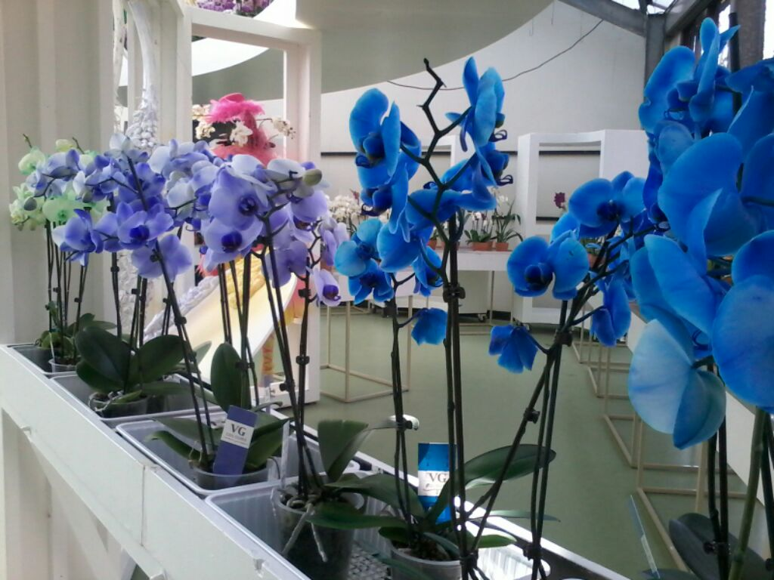
UNTUK APA
(anak-anak kita)
BELAJAR DI SEKOLAH?
oleh:
Rhiza S. Sadjad
rhiza@unhas.ac.id
http://www.unhas.ac.id/rhiza/

Slide 2




The Four Pillars
(UNESCO, 1996):
HIDUP BERSAMA
Belajar untuk ......
MENJADI
BERBUAT
TAHU

Slide 3

..... the FAILURE of the ENLIGHTENMENT in INDONESIA

Slide 4
The Enlightenment
Masa-masa pada abad pertengahan ketika Eropa dan Amerika (bangsa-bangsa Barat) bangkit dari masa “kegelapan” (the Dark Ages) sebelumnya.
“Gairah” untuk me-reformasi kehidupan keagamaan, munculnya agama Protestan sebagai anti-thesis dari agama Katolik (Roma).
Kemajuan pesat dalam bidang pengembangan Ilmu Pengetahuan dan Teknologi, ....... puncaknya: “Revolusi Industri” pada abad ke 19.

Slide 5
GAGAL
“Still, despite the growth of professional science and research in the last century, there have been few notable international achievements for Indonesian science. Looking from the outside in, Indonesian natural science has been largely unremarkable. Among the Asian scientists who have, no Indonesian scientist has ever won a Nobel Prize, and only one colonial scientist, the Dutch chemist Christiaan Eijkman, won, in 1929 for research about the causes of beriberi in chickens done in the colony during the 1890s. American universities do not recruit faculty in Indonesia. Only a select few Indonesian graduate students study or have studied in natural science departments outside of Indonesia, and those few return home to careers as scientific administrators. Most American Indonesia watchers would be hard pressed to name even a single contemporary Indonesian natural scientist. And even though Indonesia remains an important research site for tropical biologists from around the world, that research happens on a parallel track with Indonesian biology and the two worlds are distances apart. “
(Goss, 2011, hal.5)

Slide 6
Mengapa di Indonesia GAGAL ?
First, scientists established authority and legitimacy through the state.
Second, scientists have found it very difficult to connect to, let alone lead, Indonesian society.
(Goss, 2011, hal.3)

Slide 7
Latar Belakang
Competency-based Curriculum
KBK
Sekolah pada jaman kolonial .....
100 tahunan yang lalu: POLITIK ETIKA
Sekolah-sekolah didirikan Pemerintah Kolonial Hindia Belanda untuk mengisi lowongan kerja, yang seandainya pun seluruh penduduk Negeri Belanda pindah ke Hindia Belanda......... tidak akan cukup
HIS, MULO, AMS, HBS, ....... NIAS, STOVIA, THS

Slide 8
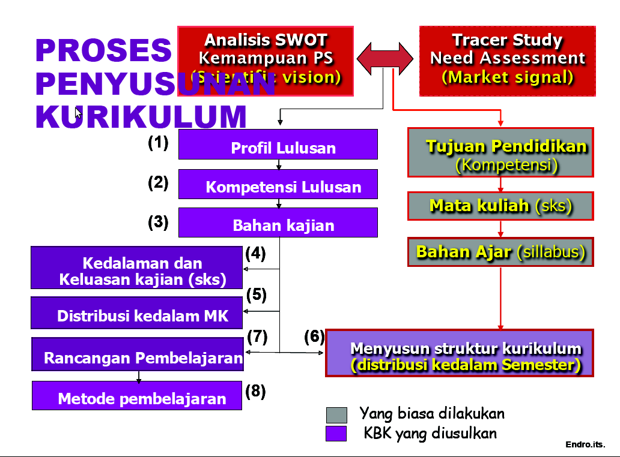
.......... Arahan DIKTI........ KBK

Slide 9
KONDISI TAHUN 2014
Dari: https://en.wikipedia.org/wiki/Good_Country_Index
Kriteria yang digunakan untuk kontribusi dalam bidang Science, Technology & Knowledge :
  Number of foreign students studying in the country relative to GDP
  Exports of periodicals, scientific journals and newspapers relative to GDP
  Number of articles published in international journals (2009 latest data) relative to GDP
  Number of Nobel prize winners relative to GDP
  Number of International Patent Cooperation Treaty applications relative to GDP

Slide 10
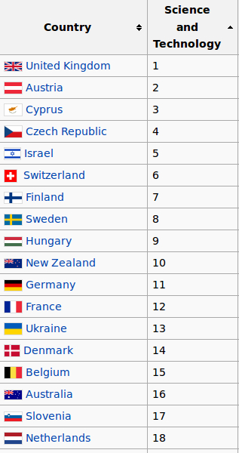
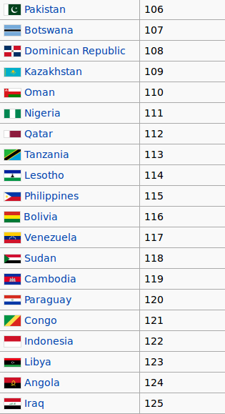
RANKING

Slide 11
PERTEMUAN dengan
Pak Mus
Siapa itu Pak Mus ............ ?
Dokumen-dokumen apa yang pernah beliau baca ?
Mengapa dokumen-dokumen itu membuat beliau “marah” ? (“modern slavery”)
“Learn to be” -----> “Learn to make .....a living”
---------> KEMANDIRIAN (visi CENDIKIA)

Slide 12
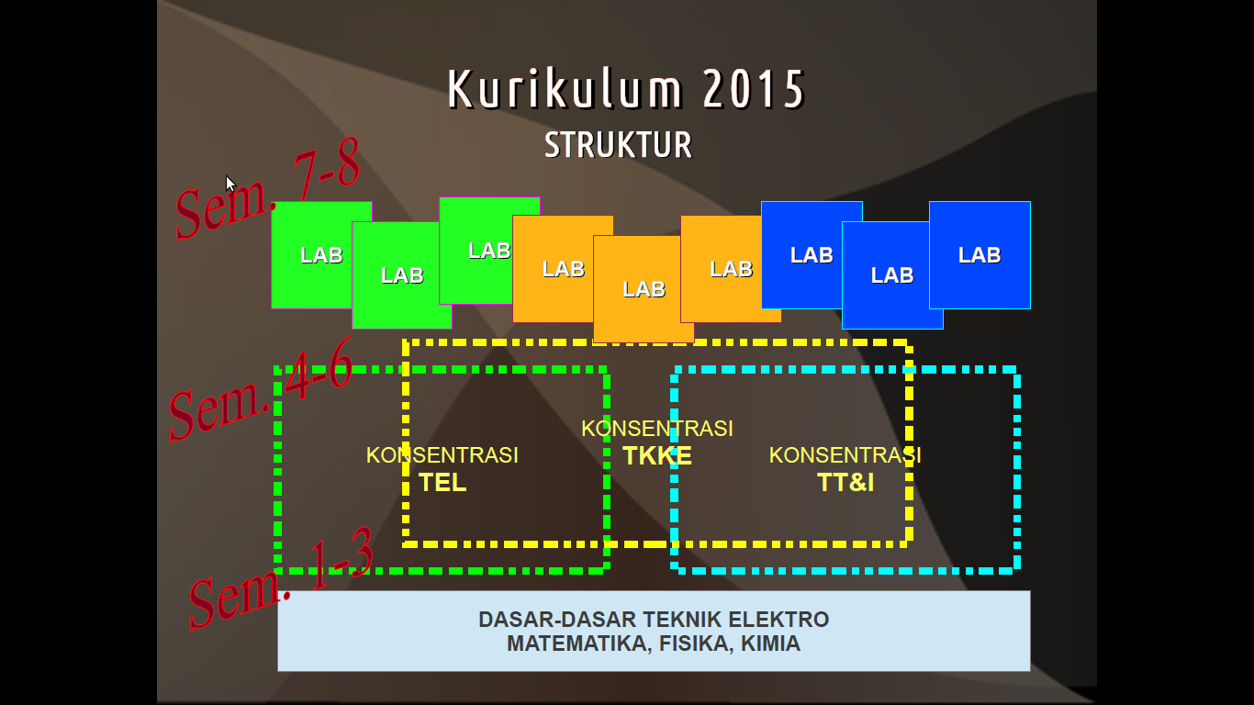
KURIKULUM BERBASIS LITBANG
(R&D-based Curriculum)
(dari KOMPETENSI ke KONTRIBUSI)

Slide 13
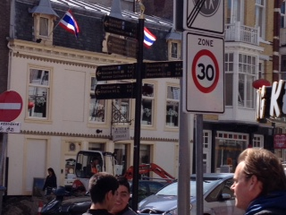
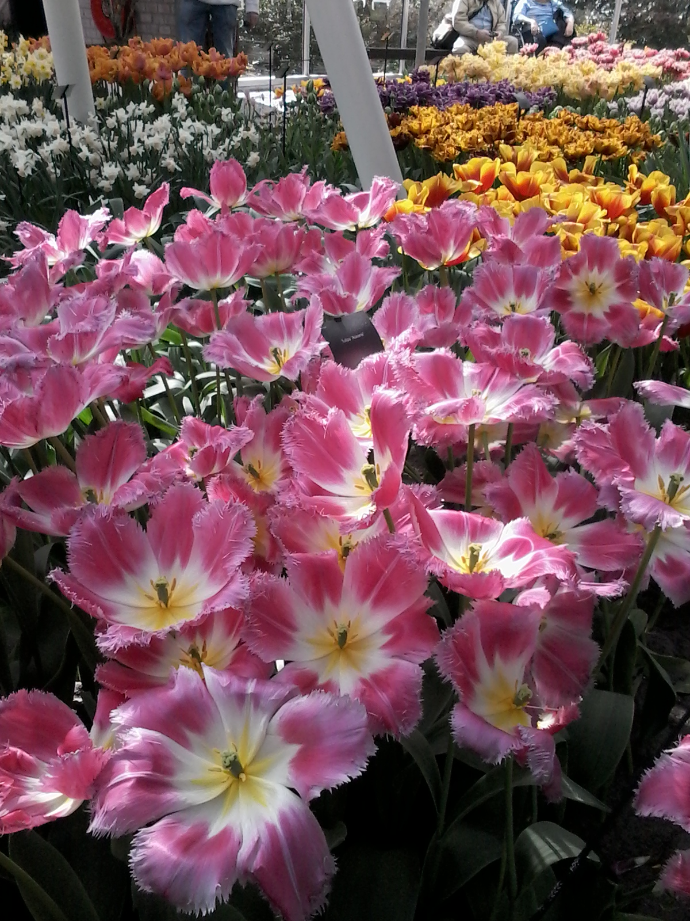
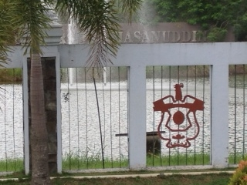
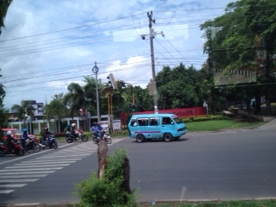

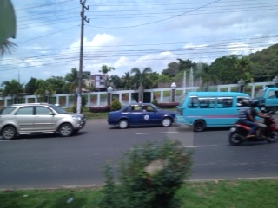
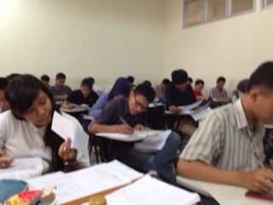
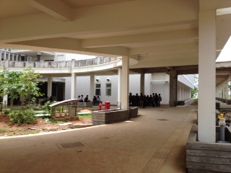
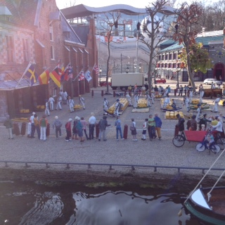
KONTRIBUSI
KOMPETENSI
SEKIAN
TERIMAKASIH

