Slide 1


Meeting on the Draft Statement of Accreditation
Civil Engineering and Electrical Engineering
Universitas Hasanuddin
24 February 2020

Slide 2
Unhas Timeline Towards ABET
(Within 18-21 Month Process)
September 2018
Institution requests
review of programs
May – June 2020
Necessary changes
to statement,
if any, are made
1st July 2019
Self-Study Report submitted to ABET
Dec 2019 – Feb 2020
Draft statements edited
and sent to institutions
August
Institutions notified
of final action
October 1st 2018
Readiness Review
Feedbacks of
Readiness Report
December 20th 2018
2018
2019
2020
Oct 18 – May 19
Institution prepares
self-evaluation
(Program Self-Study Report)
Feb – April 2020
Institutions respond
to draft statement
and return to ABET
July 2020
Commission meets
to take final action
Sept – Dec 2019
Visits take place, draft statements written and finalized following
7-day response period
October 2020
Accreditation status publically released

Slide 3

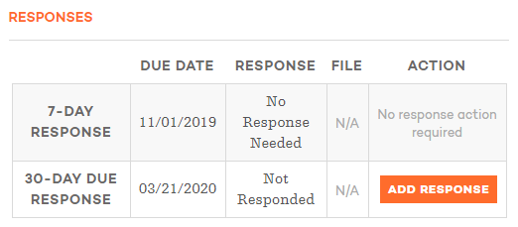
ABET Accreditation Statements

Slide 4
ABET Accreditation Statements
Deficiency. A deficiency indicates that a criterion, policy, or procedure is not satisfied. Therefore, the program is not in compliance with the criterion, policy, or procedure.
Weakness. A weakness indicates that a program lacks the strength of compliance with a criterion, policy, or procedure to ensure that the quality of the program will not be compromised. Therefore, remedial action is required to strengthen compliance with the criterion, policy, or procedure prior to the next review.
Concern. A concern indicates that a program currently satisfies a criterion, policy, or procedure; however, the potential exists for the situation to change such that the criterion, policy, or procedure may not be satisfied.
Observation. An observation is a comment or suggestion that does not relate directly to the current accreditation action but is offered to assist the institution in its continuing efforts to improve its programs.

Slide 5
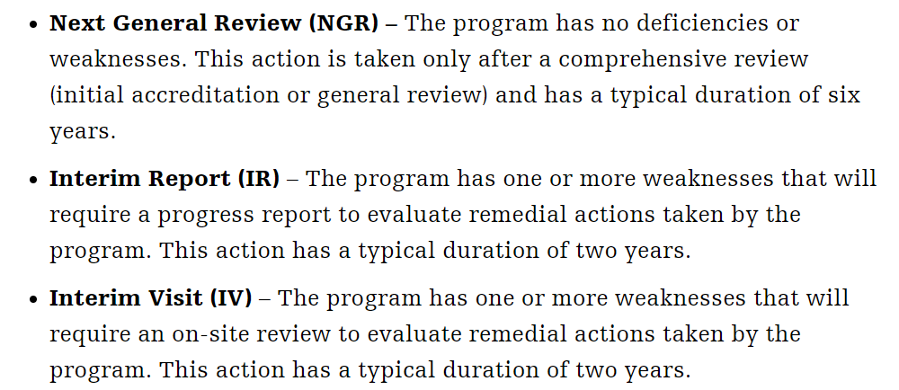
ABET Decision and Notification
👍👍
👍
ν

Slide 6
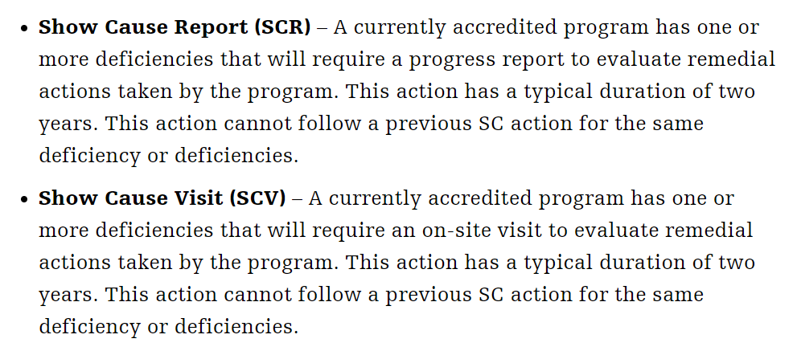
ABET Decision and Notification
?
?

Slide 7
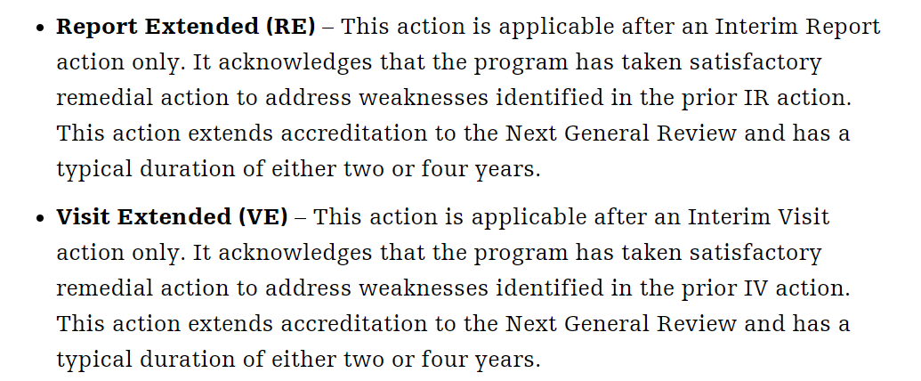
ABET Decision and Notification
X
X

Slide 8
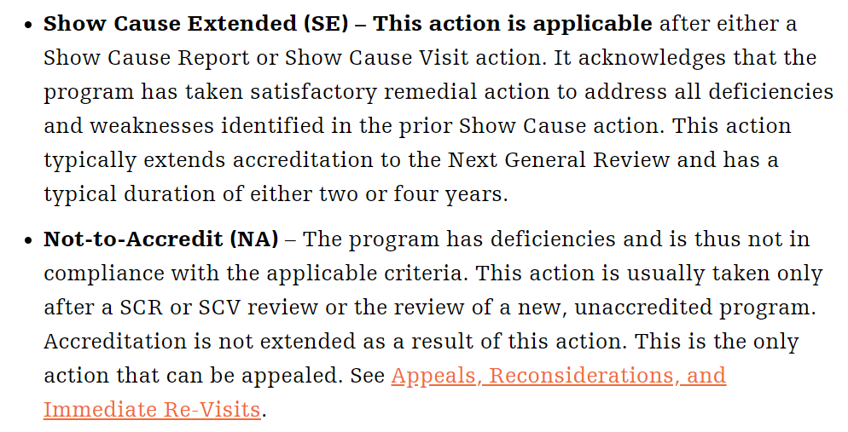
ABET Decision and Notification
X
X

Slide 9
ABET Accreditation Statements
It should be noted that a weakness or deficiency is considered to have been corrected only if the corrective action has been made effective during the academic year of the evaluation and is supported by official documentation.
Where action has been initiated to correct a problem but has not yet taken full effect or where only indications of good intent are given, the effectiveness of the corrective action cannot always be presumed; in such cases, evaluation by the Commission at the time of the next evaluation may be required.
The Commission will carefully review your institution's response to the Draft Statement, and will determine accreditation decisions during its July Meeting.

Slide 10
ABET Accreditation Statements
You should expect to receive official notification of accreditation actions together with the Final Statement during the period from mid-August to mid-September.
Neither the presence nor absence of a stated, projected accreditation action in any program discussion commits the Commission to a particular final action.
The official accreditation action for each program is taken by vote of the entire Commission at its July Meeting following consideration of the team’s findings along with the institution’s response to the Draft Statement.

Slide 11
Accreditation Statements for
Civil Engineering
Program Weakness
  Criterion 4. Continuous Improvement
Program Concern
  Criterion 1. Student
Program Observation
  Student learning experience may be enriched if practicing professionals are invited to the final presentations in the Integrated Civil Infrastructure Design Course.

Slide 12
Accreditation Statements for
Electrical Engineering
Program Weakness
  Criterion 2. Program Educational Objectives
  Criterion 4. Continuous Improvement
  Criterion 5. Curriculum
  Criterion 7. Facilities

Slide 13
Follow Up Actions
We are only have 30 days to respond the draft of accreditation statement
Civil Engineering
  Current Progress
  Action Plan
Electrical Engineering
  Current Progress
  Action Plan

Slide 14

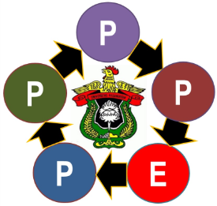
Thank You

