Slide 1
Cybersecurity Governance, Risk and Standard
Sarwono Sutikno, Dr.Eng., CISA, CISSP, CISM
Keynote speech – MICEEI 2014 – makasar 26-30 Nov 20141

Slide 2
Sarwono Sutikno, Dr.Eng., CISA, CISSP, CISM
Current:
Cybersecurity Nexus Liaison ISACA Indonesia
ISACA Academic Advocate at ITB
SME for Information Security Standard for ISO at ISACA HQ
Associate Professor at School of Electrical Engineering and Informatics, Institut Teknologi Bandung
Ketua WG Layanan dan Tata Kelola TI, anggota WG Keamanan Informasi serta Anggota Panitia Teknis 35-01 Program Nasional Penetapan Standar bidang Teknologi Informasi, BSN – Kominfo.
Past:
Director of Certification – CRISC & CGEIT, ISACA Indonesia Chapter
Ketua Kelompok Kerja Evaluasi TIK Nasional, Dewan TIK Nasional (2007-2008)
Plt Direktur Operasi Sistem PPATK (Indonesia Financial Transaction Reports and Analysis Center, INTRAC), April 2009 – May 2011
Professional Certification:
Professional Engineering (PE), the Principles and Practice of Electrical Engineering, College of Engineering, the University of Texas at Austin. 2000
IRCA Information Security Management System Lead Auditor Course, 2004
ISACA Certified Information System Auditor (CISA). CISA Number: 0540859, 2005
Brainbench Computer Forensic, 2006
(ISC)² Certified Information Systems Security Professional (CISSP), No: 118113, 2007
ISACA Certified Information Security Manager (CISM). CISM Number: 0707414, 2007
Award:
(ISC)² Asia Pacific Information Security Leadership Achievements (ISLA) 2011 award in category Senior Information Security Professional. http://isc2.org/ISLA

Slide 3
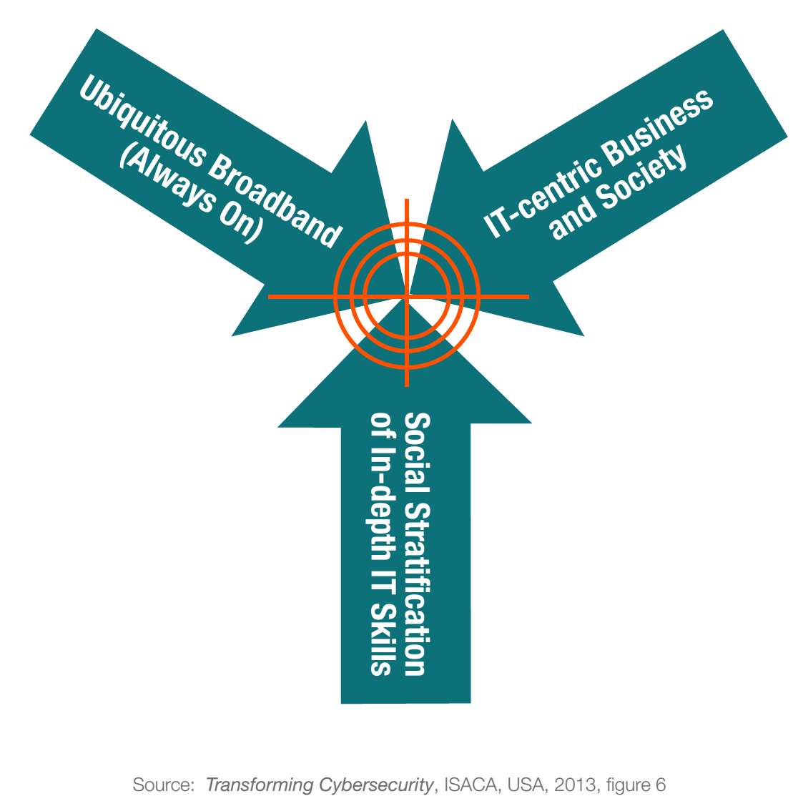
Cybersecurity – information security
Cybersecurity is emerging within the fields of
information security and traditional security to address sharp increases in cybercrime and,
in some instances, evidence of cyberwarfare.
Cybersecurity includes the protection of
information assets by addressing threats to
information that is processed, stored and
transported by internetworked information
systems.

Slide 4
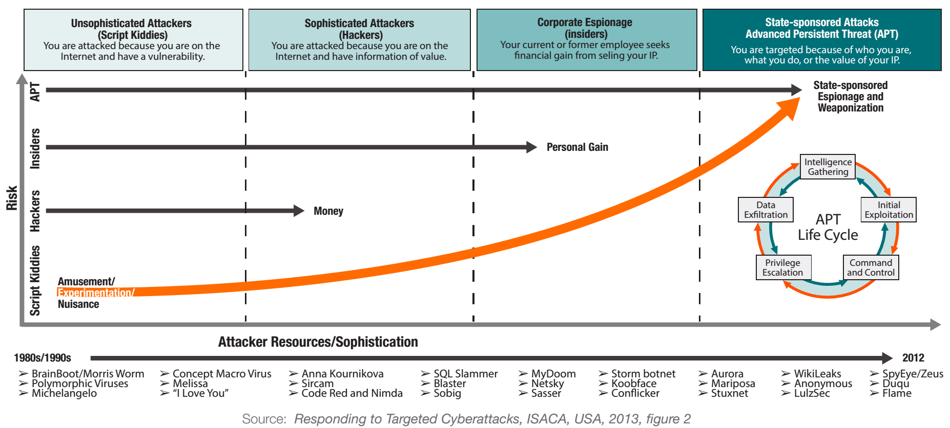
Cyberattack taxonomy

Slide 5
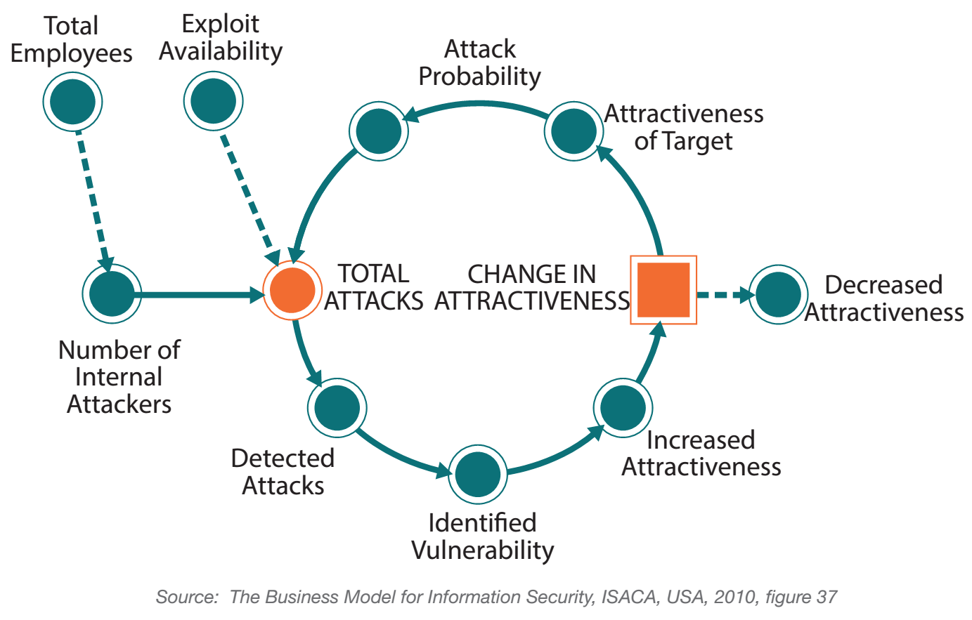
Cybersecurity system dynamics

Slide 6
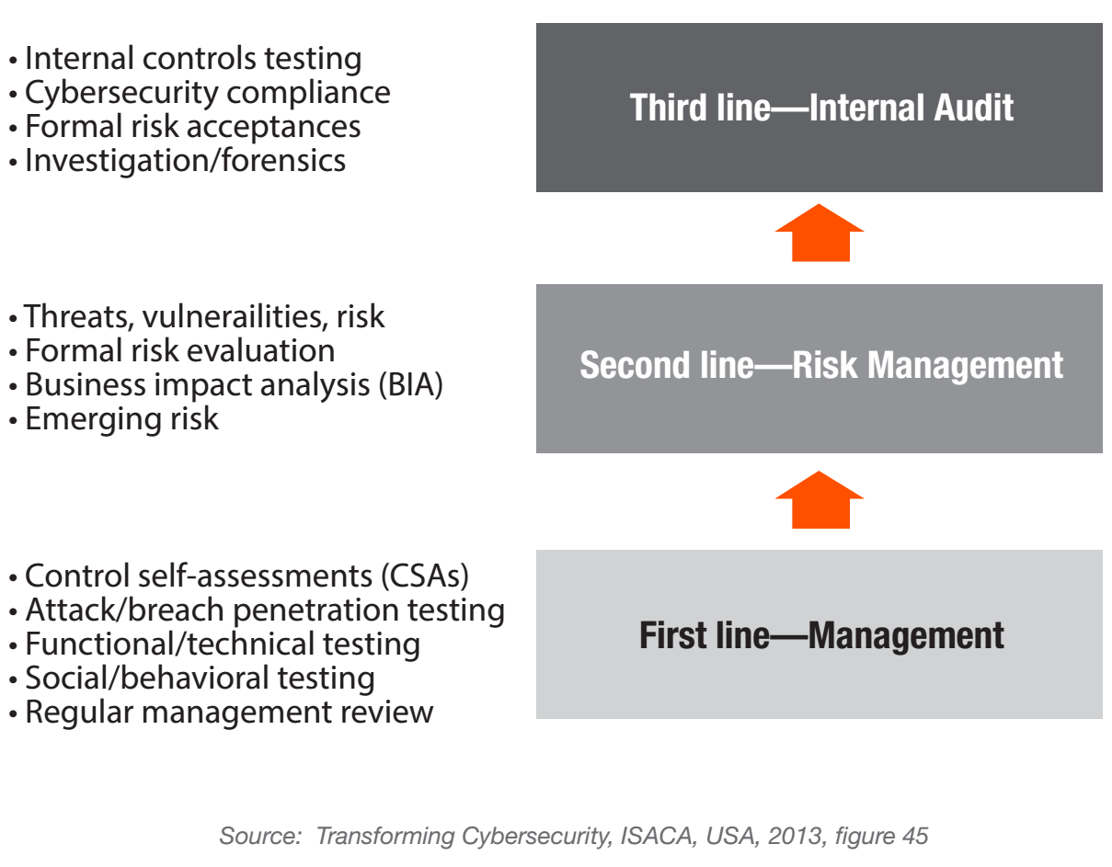
Assurance – three lines of defence

Slide 7
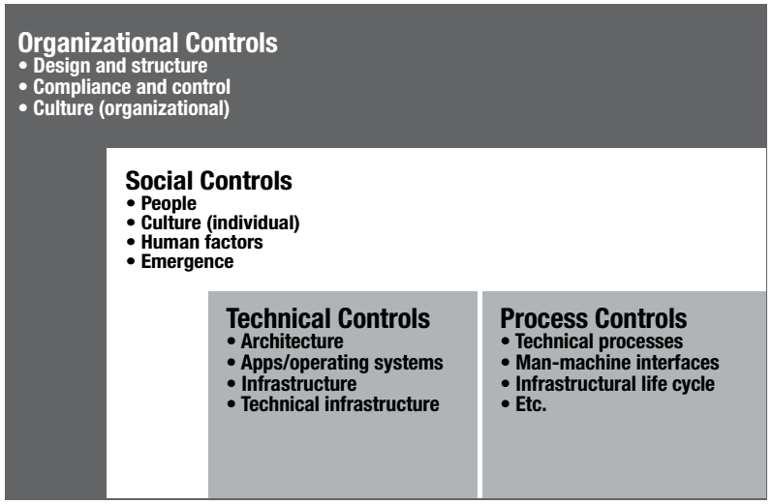
Risk based categorization of control

Slide 8
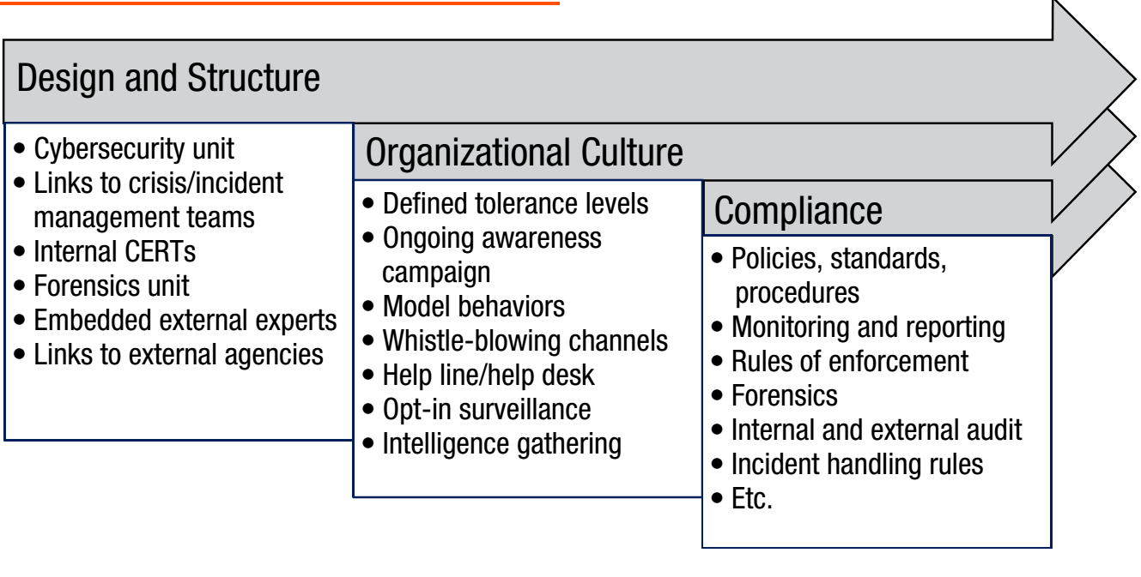
Organization layer control

Slide 9
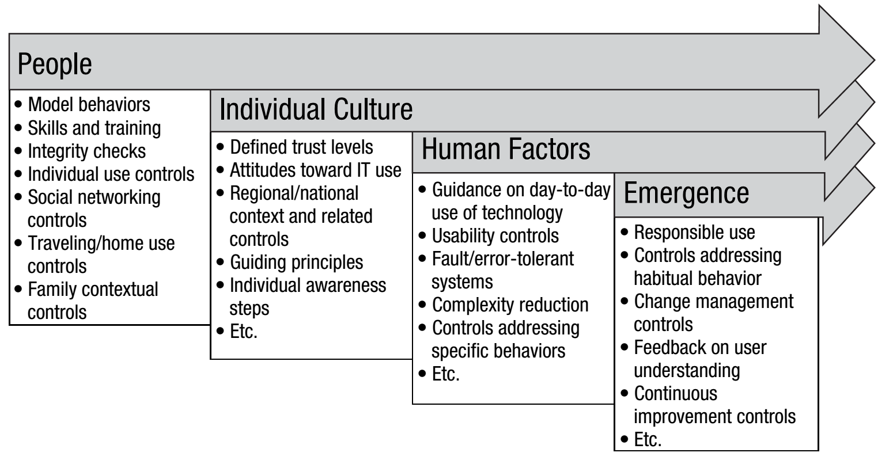
Social layer control

Slide 10
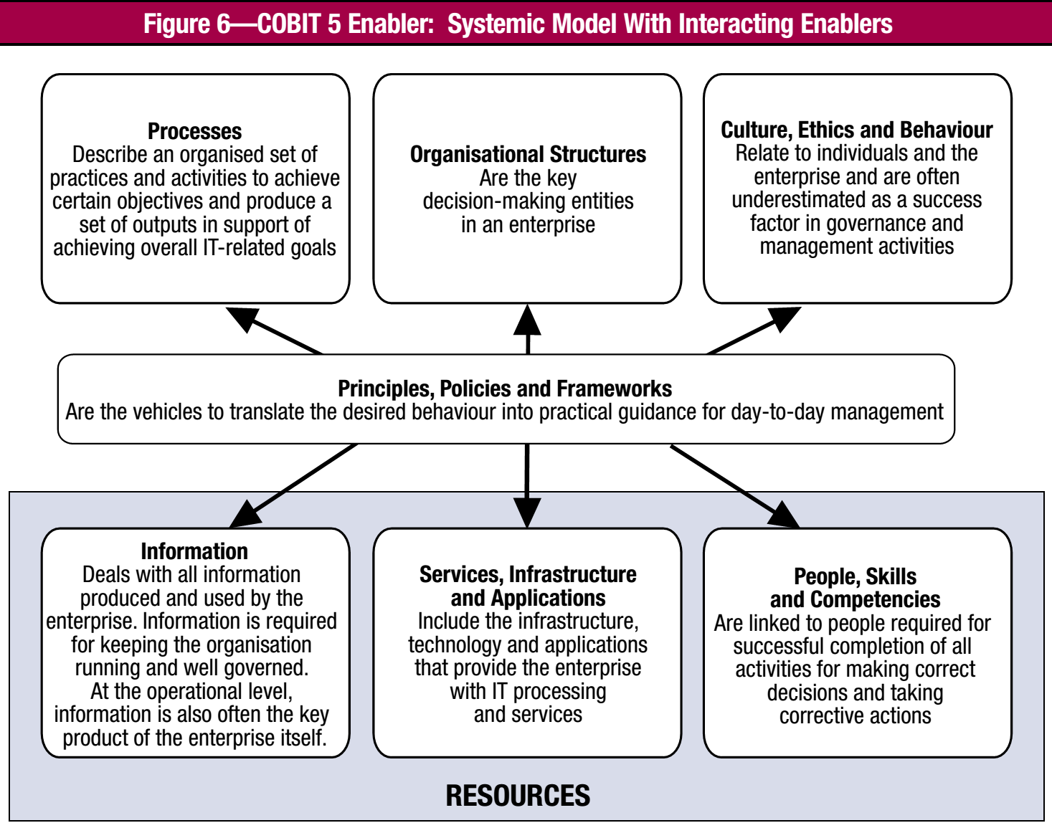
Cobit 5 for information security enabler

Slide 11
Internal control (COSO 2013)
Internal control is defined as follows:
Internal control is a process, effected by an entity’s board of directors, management, and other personnel, designed to provide reasonable assurance regarding the achievement of objectives relating to operations, reporting, and compliance.

Slide 12
Hubungan antar Kerangka
PP60/2008
Sistem Pengendalian Intern Pemerintah
Internal Control
Framework COSO
Tata Kelola
Panduan Umum Tata Kelola TIK Nas
+
Kuesioner Evaluasi Pengendalian Intern TIK
COBIT
Tata Kelola TI
SNI ISO 38500
SNI ISO 20000
SNI ISO 27001
Manajemen TI

Slide 13
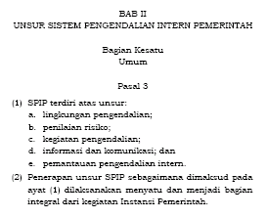
Peraturan Pemerintah RI no 60/2008 SPIP

Slide 14
Hubungan PP60/2008 SPIP dan Tata Kelola TI
Proses
Teknologi Informasi
Persyaratan Bisnis
Aturan Pengendalian
Prosedur Pengendalian
Pasal 3 (1) e. Internal Control Monitoring
Pasal 3 (1) d. Information and Communication Internal Control
Bisnis Proses, SPO, dll
TuPokSi Instansi GakKum
Peraturan Perundangan
Pasal 3 (1) c. Internal Control Activities
Pasal 3 (1) b. Internal Control Risk Assessment
Pasal 3 (1) a. Internal Control Environment

Slide 15
PP60/2008 Sistem Pengendalian Intern Pemerintah
Tata Kelola Teknologi Informasi,
PUTK-TIK Nas + KEPI-TIK v1.2.1
Best Practice (Operasional)
SNI ISO 20000-1 Manajemen Layanan Teknologi Informasi
SNI ISO/IEC 27001 Sistem Manajemen Keamanan Informasi

Slide 16
Kerangka dan Standar Keamanan Informasi
SNI ISO 27014:2014 Tata Kelola Keamanan Informasi
COBIT for Information Security
COSO
PP60/2008
SNI ISO 38500
SNI ISO 2700x
Common Criteria
SNI ISO 15408
board level
management
technical

Slide 17
Seri SNI 15408 – Kriteria Evaluasi Keamanan TI
ISO/IEC 15408-1:2009 Evaluation criteria for IT security - Part 1: Introduction and general model
SNI ISO/IEC 15408-1:2013 Teknologi informasi - Teknik keamanan - Kriteria evaluasi keamanan teknologi informasi - Bagian 1: Pengantar dan model umum
ISO/IEC 15408-2:2008 Evaluation criteria for IT security - Part 2: Security functional components
SNI ISO/IEC 15408-2:2013 Teknologi informasi - Teknik keamanan - Kriteria evaluasi keamanan teknologi informasi - Bagian 2: Komponen fungsional keamanan
ISO/IEC 15408-3:2008 Evaluation criteria for IT security - Part 3: Security assurance components
SNI ISO/IEC 15408-3:2013
Teknologi informasi - Teknik keamanan - Kriteria evaluasi keamanan teknologi informasi - Bagian 3: Komponen jaminan keamanan

Slide 18
ReferenCe
ISO, ISO/IEC 22301:2012 Societal security—Business continuity management systems—Requirements
ISO, ISO/IEC 22313:2012 Societal security—Business continuity management systems—Guidance
ISO, ISO/IEC 24762:2008 Information technology—Security techniques—Guidelines for information and communications technology disaster recovery services
ISO, ISO/IEC 27001:2013 Information technology—Security techniques—Information security management systems—Requirements
ISO, ISO/IEC 27005:2011 Information technology—Security techniques—Information security risk management.
ISO, ISO/IEC 27031:2011 Information technology—Security techniques—Guidelines for information and communication technology readiness for business continuity.
ISO, ISO/IEC 27032:2012 Information technology—Security techniques—Guidelines for cybersecurity.
ISO, ISO/IEC 31000:2009 Risk management—Principles and guidelines.
ISACA, Advanced Persistent Threat Awareness Study Results, USA, 2014,
www.isaca.org/Knowledge-Center/Research/ResearchDeliverables/Pages/Advanced-Persistent-ThreatsAwareness-Study-Results.aspx
ISACA, COBIT® 5, USA, 2012, www.isaca.org/COBIT/Pages/COBIT-5-Framework-product-page.aspx
ISACA, COBIT® 5 for Assurance, USA, 2013, www.isaca.org/COBIT/Pages/Assurance-product-page.aspx
ISACA, COBIT® 5 for Information Security, USA, 2013, www.isaca.org/COBIT/Pages/Information-Security-Product-Page.aspx
ISACA, COBIT® 5 for Risk, USA, 2013, www.isaca.org/COBIT/Pages/Risk-product-page.aspx
ISACA, European Cybersecurity Implementation: Assurance, USA, 2014
ISACA, European Cybersecurity Implementation: Audit Programme, USA, 2014
ISACA, European Cybersecurity Implementation: Resilience, USA, 2014
ISACA, European Cybersecurity Implementation: Risk Guidance, USA, 2014
ISACA, Responding to Targeted Cyberattacks, USA, 2013, www.isaca.org/Knowledge-Center/Research/ResearchDeliverables/Pages/Responding-to-Targeted-Cyberattacks.aspx
ISACA, Transforming Cybersecurity, USA, 2013

Slide 19
Discussion
www.isaca.org/cyber
Email: csx@isaca.or.id

