Slide 1
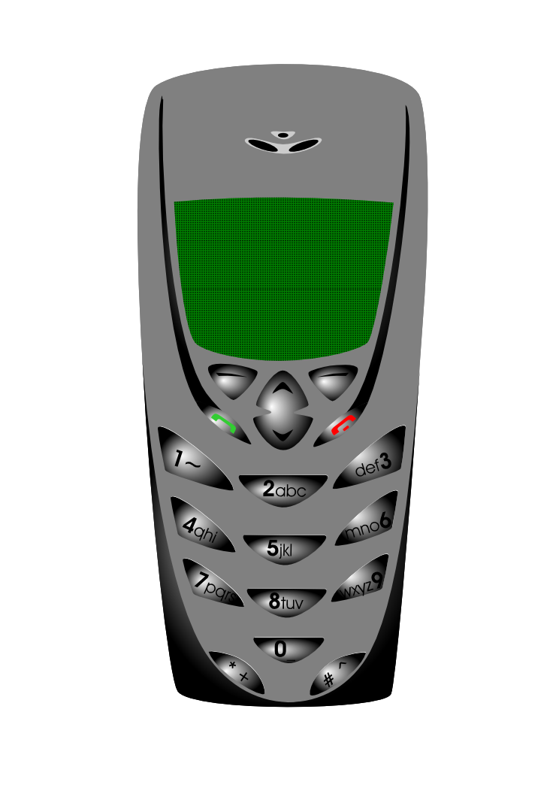





Information and Communication Technology:
The Meaning of TECHNOLOGY
TECHNOLOGY
presented by: Rhiza S. Sadjad
rhiza@unhas.ac.id http://www.unhas.ac.id/~rhiza/

Slide 2
Teknologi:
The ISOLATED meaning
The EXTENDED meaning

Slide 3
The isolated meaning of technology ........
Kamus
Thesaurus
Ensiklopedia
Wikipedia

Slide 4
Macam-macam KAMUS:
Macam-macam KAMUS
W.J.S. Poerwadarminta, ”Kamus Umum Bahasa Indonesia”, PT. Balai Pustaka, 1976:
”teknologi” = ”ilmu teknik”
”teknik”= 1 pengetahuan dan kepandaian membuat sesuatu yang berkenaan dengan hasil industri (bangun-bangunan, mesin, dsb.)

Slide 5
Macam-macam KAMUS:
Macam-macam KAMUS
”MacMillan Dictionary for Children”, MacMillan Public Coy., 1989:
”technology”:
1. The use of science for practical purposes, especially in engineering and industry
2. Methods, machines, and devices that are used in doing things in a science or profession

Slide 6
Macam-macam KAMUS:
Macam-macam KAMUS
”Webster's II New Riverside Dictionary”, Berkeley Books, NY, 1984:
”technology”:
1. The application of scientific knowledge esp. in industry or business
2. The methods and materials of applied science

Slide 7
Macam-macam KAMUS:
Macam-macam KAMUS
”The New Merriam-Webster's Dictionary ”, 1989:
”technology” = applied science
= a technical method of achieving a practical purpose
”technique” = ”technic” = the manner in which technical details are treated or basic physical movements are used
”engineering” (English) = ”teknik” (Bah. Indonesia)
= the practical application of scientific and mathematical principles

Slide 8
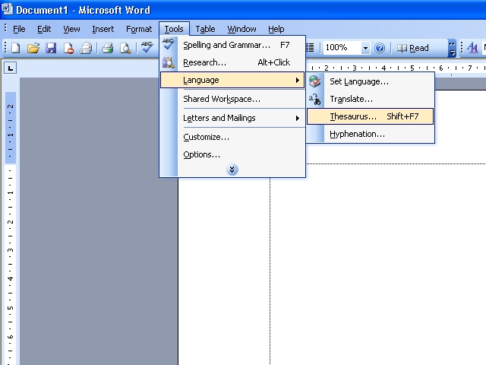
Thesaurus
Microsoft Office 2003 Thesaurus
technology: skill, knowledge, expertise, know-how, equipment, machinery, tools
engineering: manufacturing, business, commerce, trade, production
technique: method, system, practice, modus operandi, procedure, performance, skill

Slide 9
Wikipedia
http://en.wikipedia.org/
The Technology Portal
Technology (Gr. technologia (τεχνολογία) < techne (τέχνη) "craft" + logos (λόγος); "reason")
Technology predates both science and engineering. It may be defined as: "Solutions for real human problems by the development and application of tools, machines, materials, goods, or information in the form of skills, knowledge, processes, blueprints, plans, diagrams, models, formulae, tables, engineering designs, specifications, manuals, or instructions."

Slide 10

THE END
SELESAI
The END
Selamat mengikuti
KULIAH ini
dengan SEKSAMA

