Slide 1
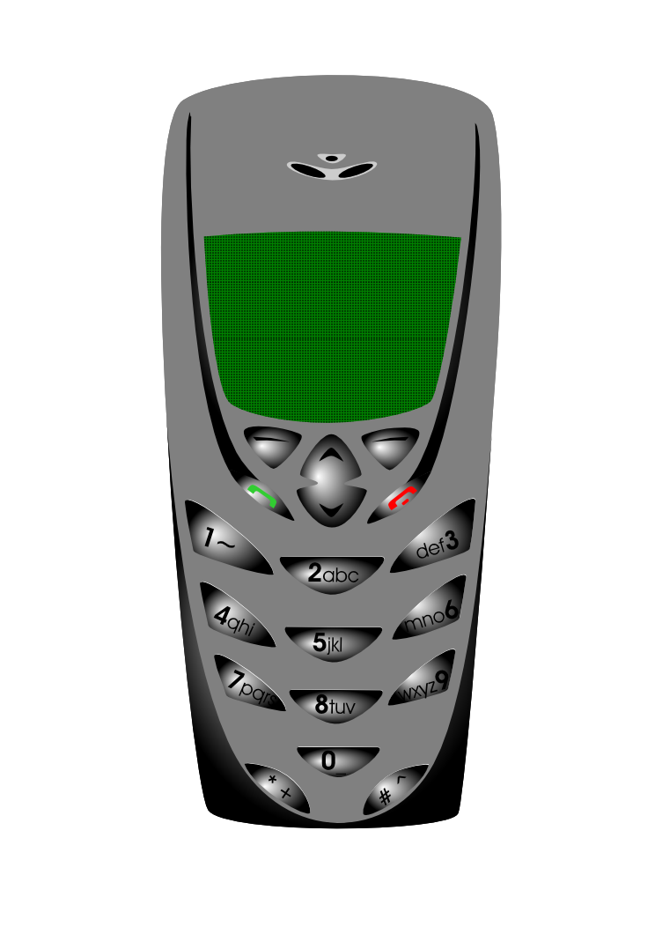

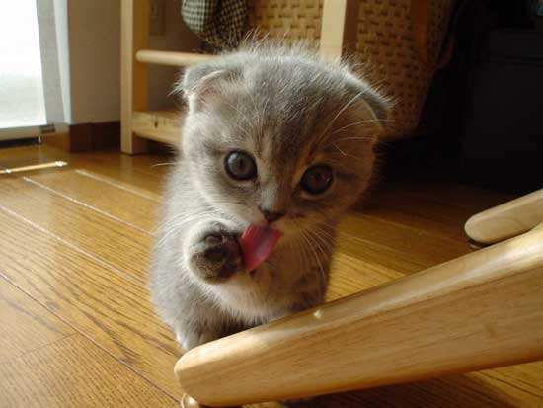

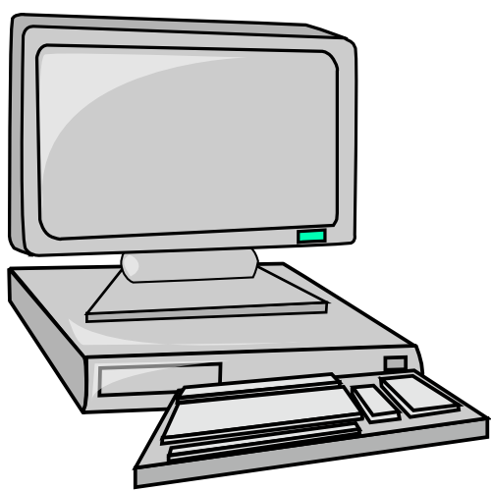

Information and Communication Technology:
A MOTIVATION
A MOTIVATION
presented by: Rhiza S. Sadjad
rhiza@unhas.ac.id http://www.unhas.ac.id/rhiza/

Slide 2
Question:
Why should we study ICT?

Slide 3

Today ..............
From Hiroshima-Nagasaki
to WTC 911, .........
.............. natural and social DISASTERS
............. a very very STRESSFUL
world of TODAY !

Slide 4
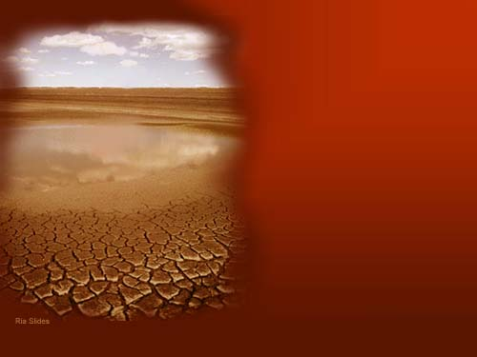
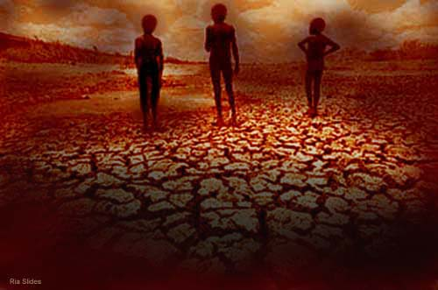

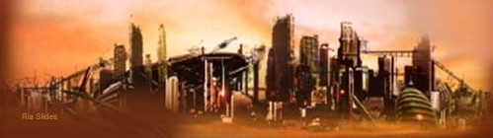
The FUTURE of our EARTH.....?
2070
E A R T H

Slide 5

The HISTORY of CIVILIZATION
The History of Civilization
The ERA of
The CENTRAL Issue
Historical Events
Agriculture
Land
Social Revolution and Independence
Industry
Energy
HIROSHIMA NAGASAKI
INFORMATION
Information
WTC 911

Slide 6
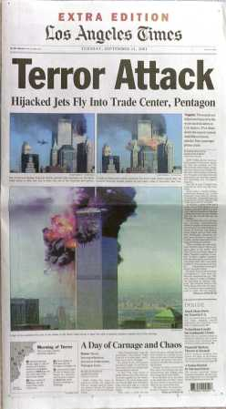
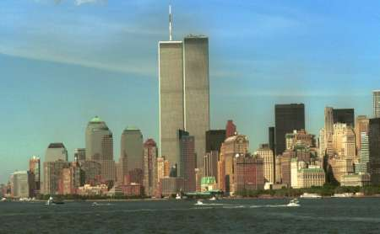
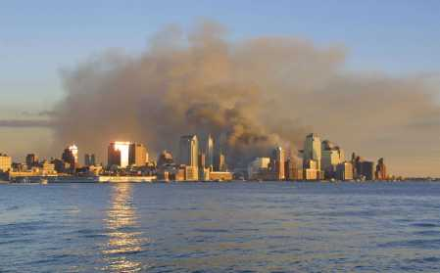
WTC 911

Slide 7
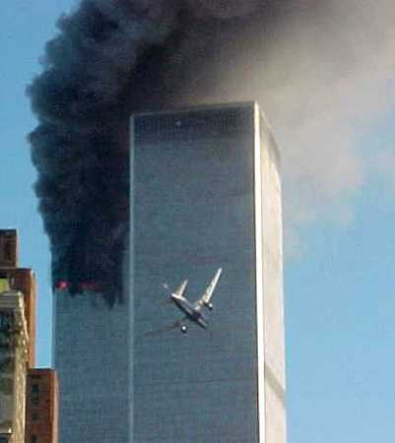
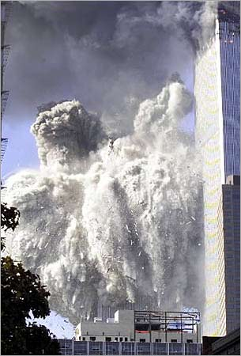
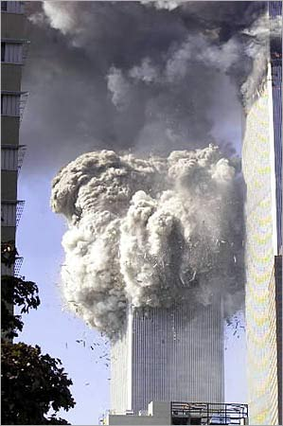
WTC 911

Slide 8
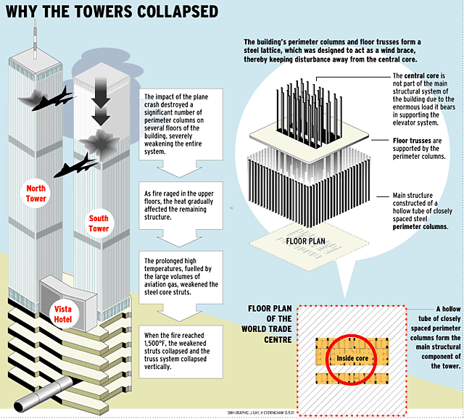

Slide 9
The
INFORMATION
SOCIETY
The “real”
SOCIETY
The virtual “society”
The GLOBAL Information ERA !

Slide 10
The Information Society
The Work Force Composition
Information
47 %
Services
Industry
29 %
Agriculture
22 %
1800-
1820-
1840-
1860-
1880-
1900-
1920-
1940-
1960-
2 %
1820
1840
1860
1880
1900
1920
1940
1960
1980
Gambar 1
The Change of the Work Force Composition in the USA 1800-1980
(Source:: Everett M. Rogers, [
1986
], “
Communication Technology
”, page 11)‏

Slide 11
Information Workers
Individuals whose main activities are .......
PRODUCING………..
PROCESSING..........
DISTRIBUTING.....……..
INFORMATION
producing
The INFORMATION
TECHNOLOGY
…………………. teachers, lecturers, academicians, reseachers, writers, reporters, managers, public relation, etc.... .
CIO

Slide 12
Key Social Institutions
Society
Key Social Institution
Agricultural
FARM
Industrial
FACTORY
Information
UNIVERSITY
(Source: Everett M. Rogers, [
1986
], “
Communication Technology
”, hal. 13)‏

Slide 13

The INDONESIAN Information Societies:
P
esantren
PESANTREN SEKOLAH KAMPUS
S
ekolah
K
ampus
Masyarakat INFORMASI

Slide 14
SELESAI
The END
THE END
Selamat mengikuti
KULIAH ini
dengan SEKSAMA

