Slide 1
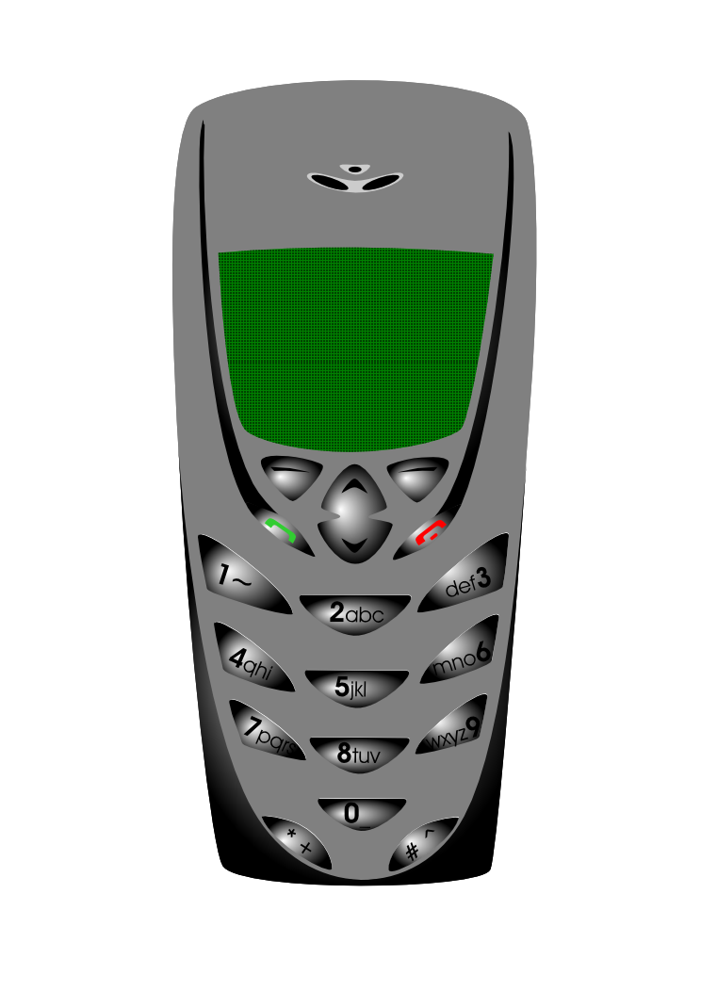



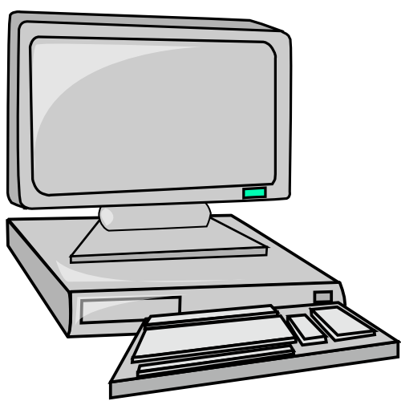

Information and Communication Technology:
INFORMATION
(the extended meaning)
INFORMATION
presented by: Rhiza S. Sadjad
rhiza@unhas.ac.id http://www.unhas.ac.id/~rhiza/

Slide 2
INFORMATION
(the extended meaning)
(more about) The Information Society
The Information Workers
The Information System

Slide 3
An information society is a nation in which a majority of the labor force is composed of information workers, and which information is the most important element. (Rogers, [1986], page 10)‏
Welcome to the Information Society !
The INFORMATION
SOCIETY
The “Real”
Society
“VIRTUAL” SOCIETY

Slide 4
The Information Society
Work Force Composition
(USA, 1800-2000)
INFORMATION
47 %
SERVICES
INDUSTRY
29 %
AGRICULTURE
22 %
2 %
1800-
1820-
1840-
1860-
1880-
1900-
1920-
1940-
1960-
1820
1840
1860
1880
1900
1920
1940
1960
1980
(Source: Everett M. Rogers, [
1986
], “
Communication Technology
”, page 11)‏

Slide 5
The Information Workers:‏
Those who make their living by:
producing ………..
processing……………..
distributing……..
INFORMATION
and
producing
The Information Technology
(Rogers, [1986], page 10)‏
CIO
…………………. teachers, lecturers, researchers, academicians ......, manager, secretary

Slide 6

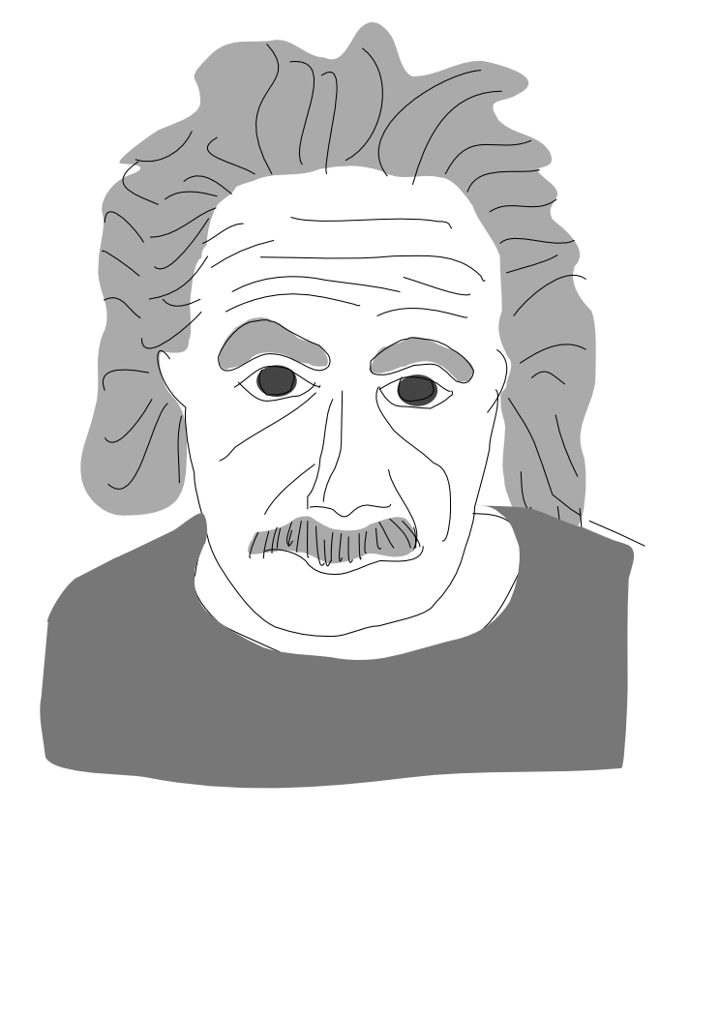





Main type of employment
Society
Profession
Agricultural
FARMERS
Industrial
FACTORY Workers
Information
INFORMATION Workers
(Source: Everett M. Rogers, [
1986
], “
Communication Technology
”,page. 13)‏

Slide 7





Key Social Institutions
Society
Key Social Institution
Agricultural
FARM
Industrial
FACTORY
Information
RESEARCH UNIVERSITY
(Source: Everett M. Rogers, [
1986
], “
Communication Technology
”,page. 13)‏

Slide 8





Key element/basic resource
Society
Key element
Agricultural
FOOD
Industrial
ENERGY
Information
INFORMATION
(Sumber: Everett M. Rogers, [
1986
], “
Communication Technology
”, page. 13)‏

Slide 9


Basic Technology
Society
Technology
Agricultural
Manual Labor
Industrial
Steam Engine
Information
Computer and Electronics
(Source: Everett M. Rogers, [
1986
], “
Communication Technology
”, page. 13)‏

Slide 10





Nature of Mass Communication
Society
Nature
Agricultural
One way print media (publishing)‏
Industrial
One way electronic media (broadcasting)‏
Information
Interactive, de-massified
(Source: Everett M. Rogers, [
1986
], “
Communication Technology
”, page. 13)‏

Slide 11

Another extended meaning of INFORMATION .............
The INFORMATION SYSTEM
The INFORMATION SYSTEM

Slide 12

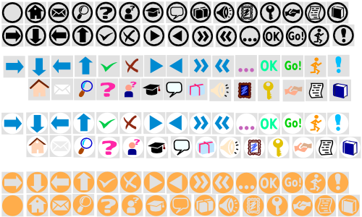
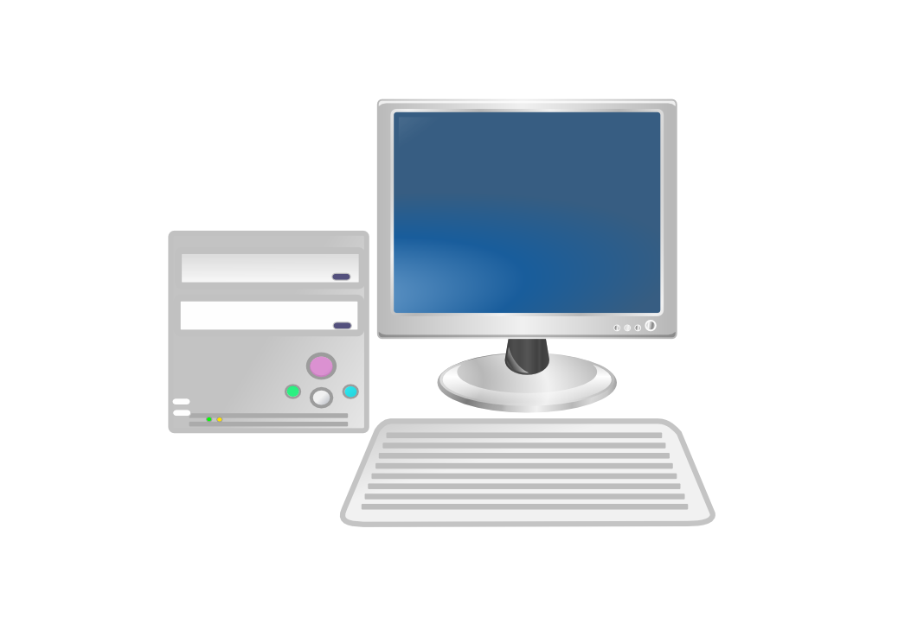
FRONT DOOR ..............!
Financial
HRM
Asset
Office
etc.
TOP
e-marketting
e-procurement
MANAGEMENT
Public Relations
INFORMATION
humanware
software
The INFORMATION SYSTEM
hardware

Slide 13






.................BACK DOOR!
INFORMATION
humanware
The INFORMATION SYSTEM
software
hardware
DATA
DATA-BASE
INPUT DATA
(DATA ENTRY)‏

Slide 14
The Levels of INFORMATION SYSTEMS
MANUAL
MANUAL-based INFORMATION SYSTEMS
COMPUTER-based INFORMATION SYSTEMS
NETWORK-based INFORMATION SYSTEMS
COMPUTER
NETWORK
humanware
software
hardware

Slide 15
Levels of Information Systems (1)‏
LEVEL
Hardware
Software
Characteristics
MANUAL-based
Pencils, ballpoints, pens, notebooks, typewriters, computers
Non-Available,
onlly “generic”, such as word processors, spread-sheet, etc.
Rely on human capabilities, such as memory, accountability, etc.

Slide 16
Levels of Information Systems (2)‏
Level
Hardware
Software
Characteristics
COMPUTER generally PCs
Specifically developed application software package, for example: Academic Information Systems, etc.
Most tasks that are relying on human capabilities have been taken over by computers programs.
COMPUTER-based

Slide 17
Levels of Information Systems (3)‏
Level
Hardware
Software
Characteristics
NETWORK-based
(on-line)
COMPUTER(PC, Workstation, Server), network components (NIC, HUB, BRIDGE, SWITCH), Tele-communication Systems
Network-based Application software packages
Resource sharing, accessible from other networks.

Slide 18

THE END
SELESAI
The END
Selamat mengikuti
KULIAH ini
dengan SEKSAMA

