Slide 1
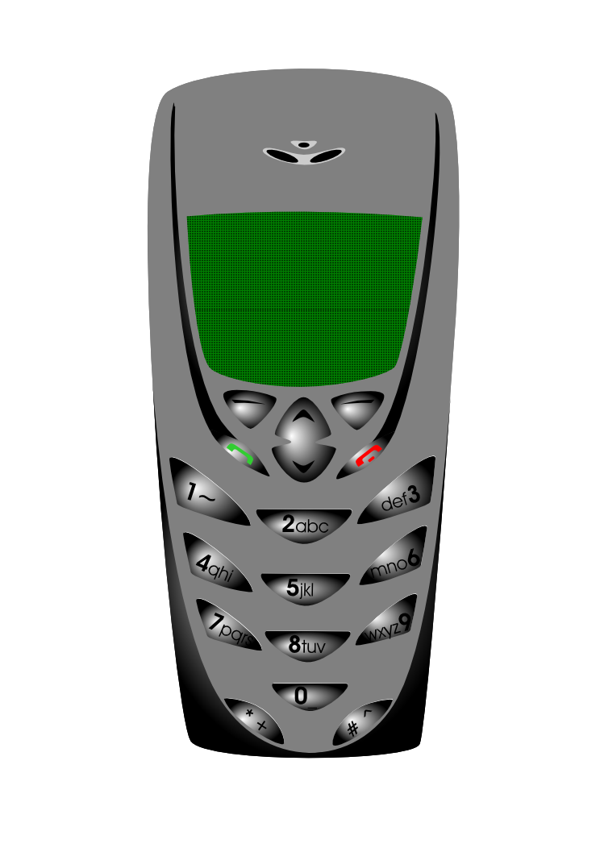





Information and Communication Technology:
A LITTLE MORE ABOUT
THE COMMUNICATION TECHNOLOGY
The
Technology
COMMUNICATION
presented by: Rhiza S. Sadjad
rhiza@unhas.ac.id http://www.unhas.ac.id/rhiza/

Slide 2

Communication Model
Shannon and Weaver [1949], simplex mode
INFORMATION
SOURCE TRANSMITTER RECEIVED RECEIVER DESTINATION
SIGNAL SIGNAL
MESSAGE MESSAGE
NOISE
SOURCE
Fig. 1 — Schematic diagram of a general communication system.
Communication Channel
The Information Theory

Slide 3
The MODEs of Communication
Shannon and Weaver [1949], simplex mode
INFORMATION
SOURCE TRANSMITTER RECEIVED RECEIVER DESTINATION
SIGNAL SIGNAL
MESSAGE MESSAGE
NOISE
SOURCE
Fig. 1 — Schematic diagram of a general communication system.
Communication Channel
The MODEs of Communication:
The SIMPLEX MODE (the model above)
The DUPLEX MODE: Full Duplex and Half Duplex
Schweber, [1996], page 18-20ion

Slide 4


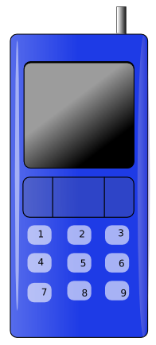


The MODEs of Communication
Shannon and Weaver [1949], simplex mode
INFORMATION
SOURCE TRANSMITTER RECEIVED RECEIVER DESTINATION
SIGNAL SIGNAL
MESSAGE MESSAGE
NOISE
SOURCE
Fig. 1 — Schematic diagram of a general communication system.
Communication Channel
Handy-Talky
HALF-DUPLEX (two SIMPLEXs, one at the time)‏
FULL-DUPLEX (two SIMPLEXs)‏
SINGLE-SOURCE SINGLE-DESTINATION

Slide 5
The MODEs of Communication
not a simplex mode
not a full-duplex
not a half-duplex, but ..........
the NETWORK !
The NETWORK Mode
MULTI-SOURCE MULTI-DESTINATION

Slide 6


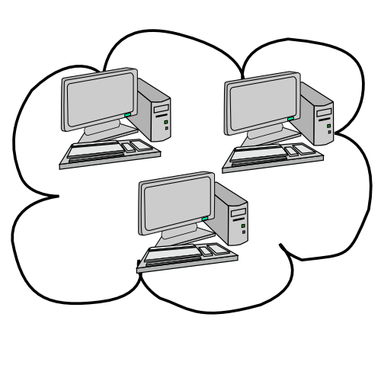
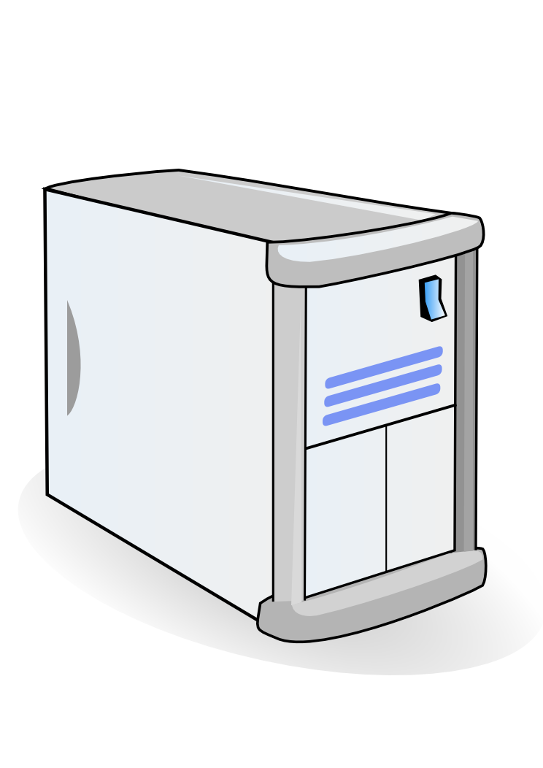


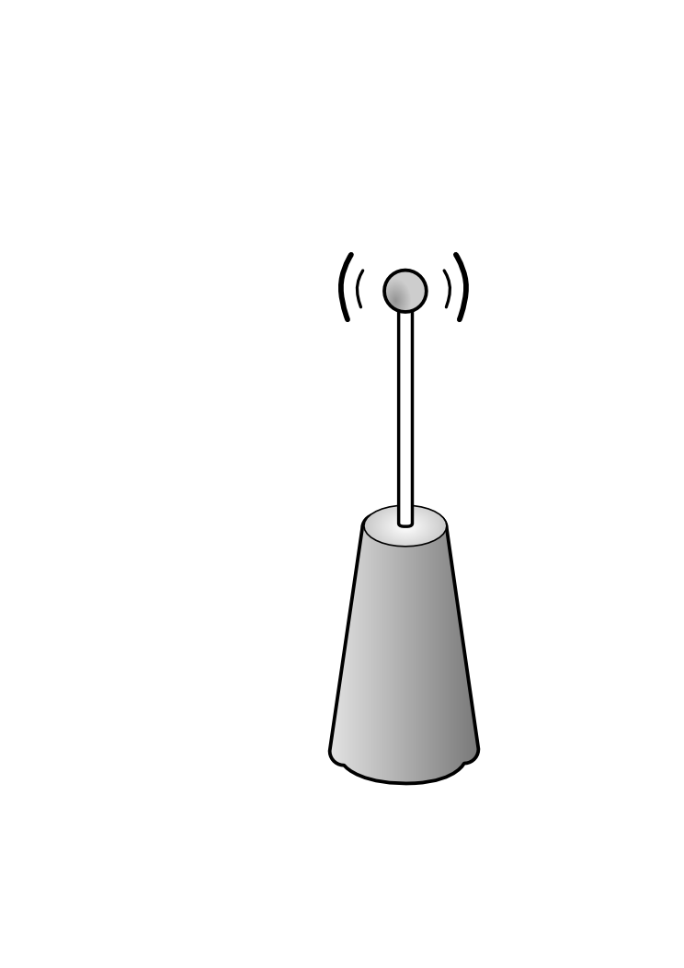

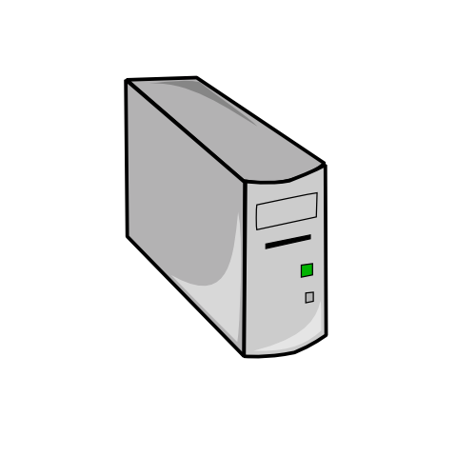
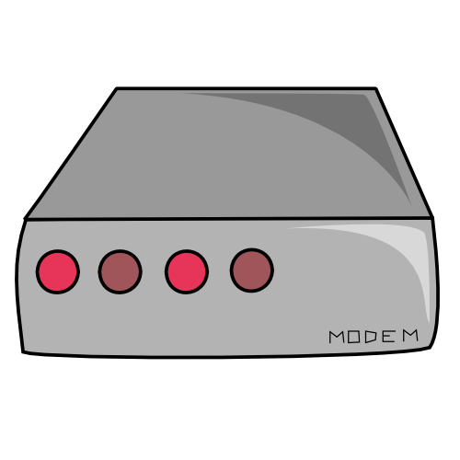
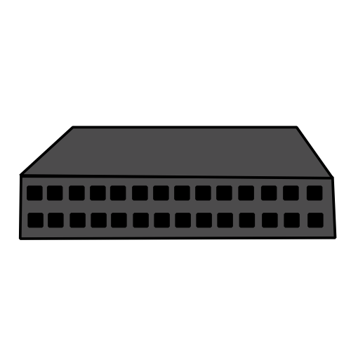
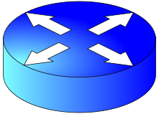
The NETWORK mode‏
on NETWORK
MULTI-SOURCE MULTI-DESTINATION

Slide 7
MODE JARINGAN (Network)‏
on NETWORK
All kinds of NETWORK:
LOCAL AREA NETWORK (LAN)‏
WIDE AREA NETWORK (WAN)‏
METROPOLITANT AREA NETWORK (MAN)‏
CAMPUS AREA NETWORK (CAN)‏
The INTRANET
The INTERNET
MULTI-SOURCE MULTI-DESTINATION

Slide 8
The INTERNET ........
Read : http://en.wikipedia.org/wiki/History_of_the_Internet
A “non-hierarchical” organization
Members: Computers and the Accessories
“Permanent” and “Temporary” members
Every single member has its ”IP address” (IP = Internet Protocol) :
  Versi 4: 000.000.000.000 to 255.255.255.255, ”local” and ”public” IP
  Ipv6 (versi 6)‏

Slide 9
The INTERNET member........
Every single member of the Internet has its specific function:
  servers: mail-server, file-server, web-server, list-server, Domain-Name Server (DNS), dll...........
  routers: the traffic controllers
  bridges‏: connecting networks
  terminal, client
  etc.

Slide 10



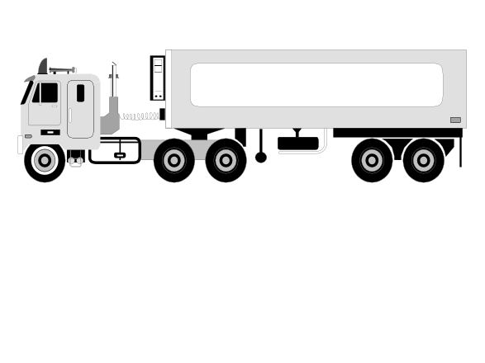

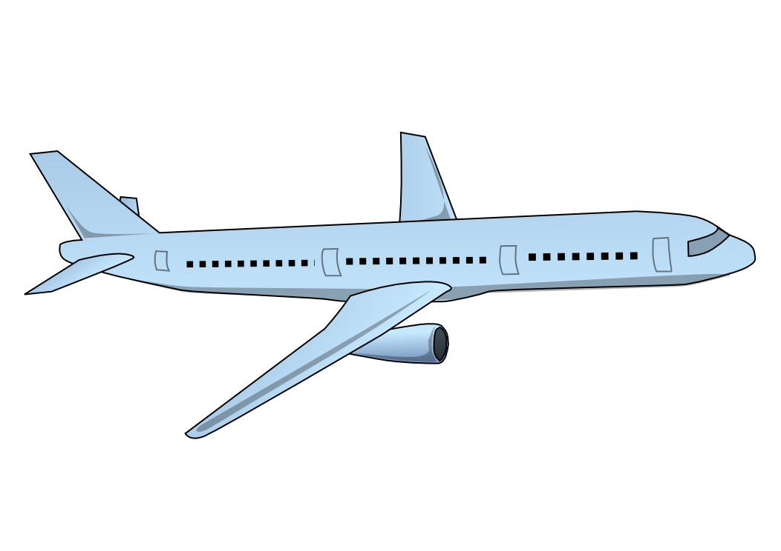



Packet Data Communication ........
Using a communication protocol: TCP/IP
Communication by sending and receiving DATA PACKETS
Each DATA PACKET has its CONTENTS and its ”WRAPPER”, its SENDER's Address and its DESTINATION/RECEIVER's Address

Slide 11
to see .......the
Let's Go .....
Internet ......
INTERNET

