Slide 1
LANGUAGE LABORATORY
AND
ICT ACCESS
GROUP REPORT
NUNUNG ANUGRAWATI
MAHARIDA MANINDAR
ANNISAH
MUH. HARUN
BAHARUDIN ADU

Slide 2
LOCATION
Name : Language Laboratory and ICT Access
Venue : A.9 room, A building, third floor, Faculty of Teacher Training and Education, Muhammadiyah University of Makassar.
Contact person : Aliem Bahri,. S.Pd,. M.Pd
The Coordinator of Language Laboratory and ICT access
HP : 081355611224
Staff : Nasruddin Galang, S.Pd
CP: 085240003103

Slide 3
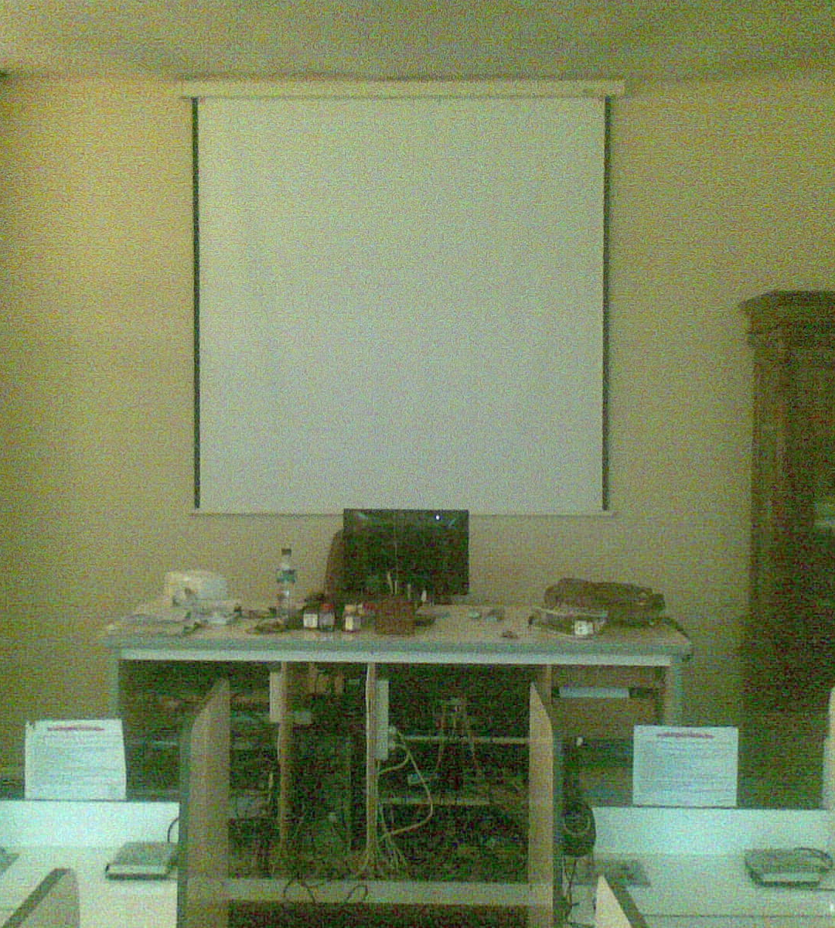
T

Slide 4
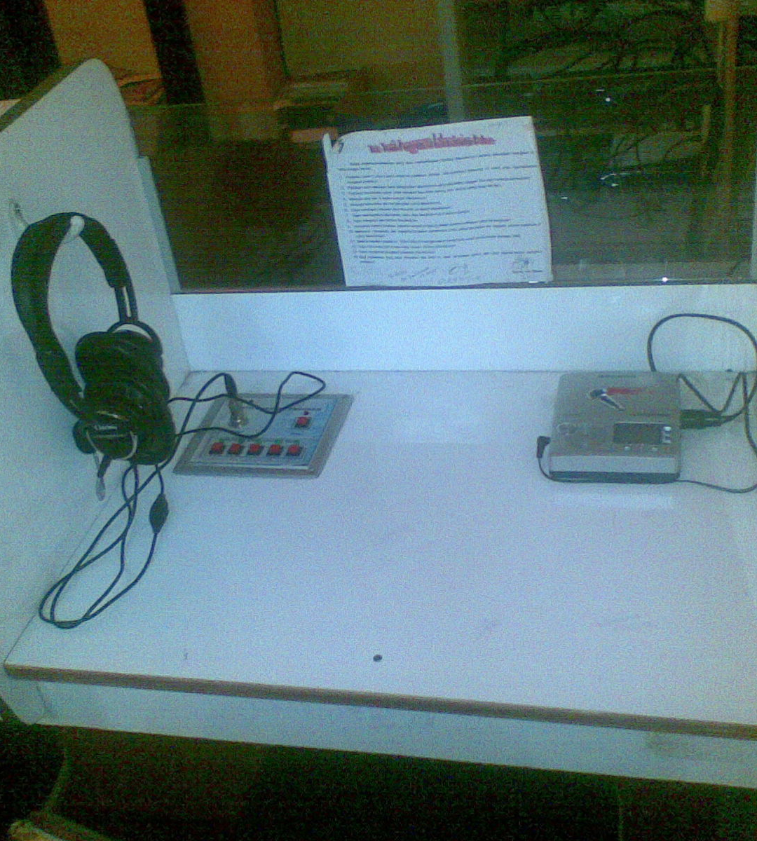

Slide 5
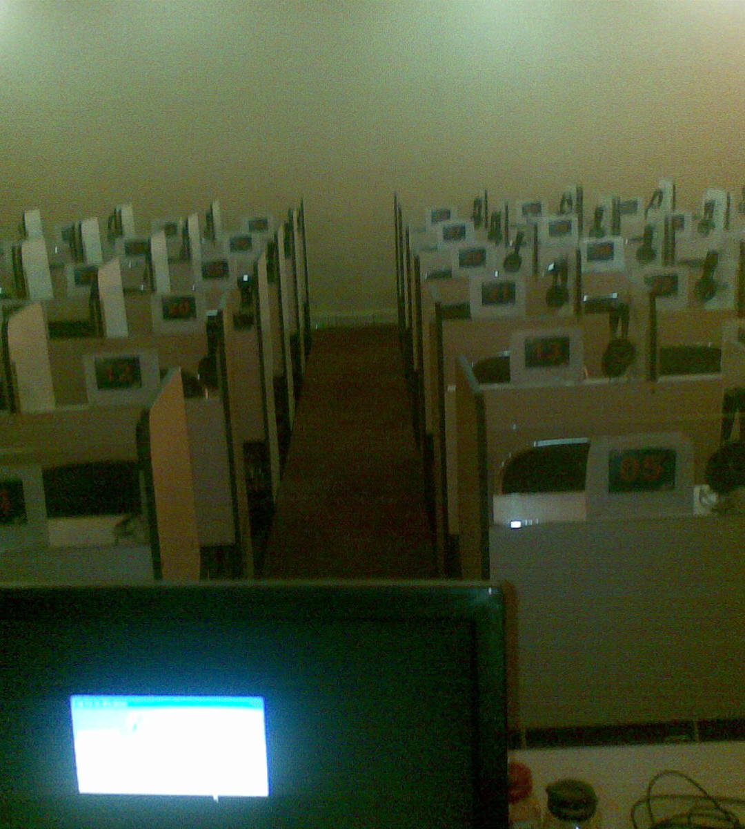

Slide 6
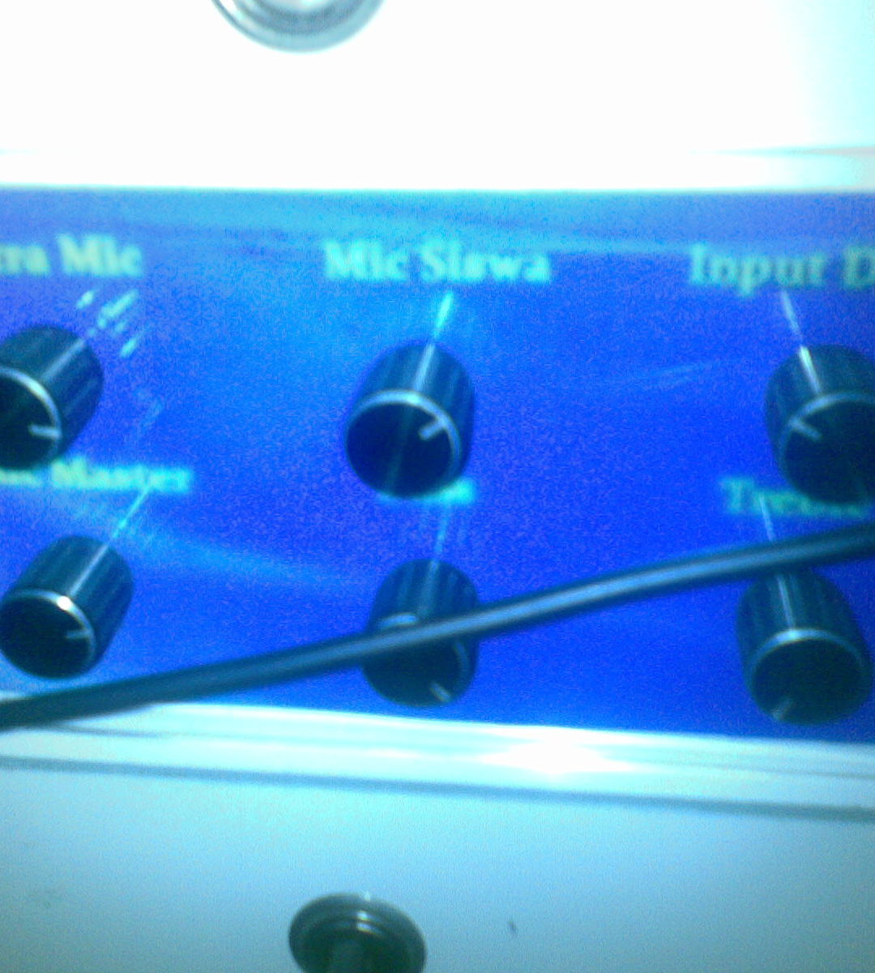

Slide 7
INVESTIGATION AND OBSERVATION ON:
SOFTWARE ASPECTS
HARDWARE ASPECTS
HUMANWARE ASPECTS

Slide 8

SOFTWARE ASPECTS
1. Internet service
(www.unismuh.co.id), can be linked with 8 faculties and all access to some information, such as : PPKHB, PLPG, SERTIFIKASI DOSEN, DARMASISWA SCHOLARSHIP, and INTERNATIONAL RELATIONSHIP.

Slide 9
CONT……
2. System :
One system for all, controlled by the university, and then it is broadcasted to each faculty, so each faculty can spread out the connection for every students depends on the area they are.

Slide 10
CONT……
3. Server : ictlink and FKIP zone
bit rate : 1500bps or 1,5 Mbps

Slide 11
HARDWARE ASPECTS
1. 35 sets of Computers, LG brand
2. 2 sets of printers, HP brand
3. LCD projectors and tabulation screen, Samsung brand
4. A set of sound system, Simbadda brand
5. A set of master control of Language laboratory
6. 40 sets of table for audio, include head set, earphone, master control for each table, and vacuum facilities to reduce noisy both of from inside and outside.
7. A set of CCTV, put in every corners of the room.

Slide 12
HUMANWARE ASPECTS
Mastery
2 staffs with different level ability:
The coordinator had been in it since 5 years ago, qualified for train every lecturer and students.
One staff as room keeper, maintain, and service in the access.

Slide 13
CONT…
2. Safety
The tools, include and software and hardware, are sensitive and high risk, the staffs are able to fix the problems which occurs, and especially for electrical disturbance.

Slide 14
CONT…
3. Qualification
Staffs are able to operate the tools and give training to others according to the ICT’s needs, such as:
-Browsing and surfing
-Operating Language laboratory
-Operating computers and the system holistically
-Teaching integratively with internet display
Using audio combined with LCD screen
Fix and service for current problems
Connectivity and electricity

Slide 15


THANK YOU

