Slide 1

Ready???

Slide 2
3

Slide 3
2

Slide 4
1

Slide 5
ICT

Slide 6
GROUP 1
ULFA MUSYRIHA (13B01142)
ARMITA PERMATASARI (13B01143)
SAMRA (13B01153)
SURYANI JIHAD (13B01141)
ANDI NIAR REZKY (13B01145)
MURSAL (13B01152)

Slide 7

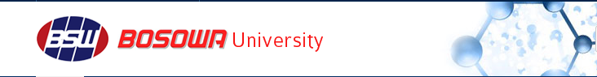
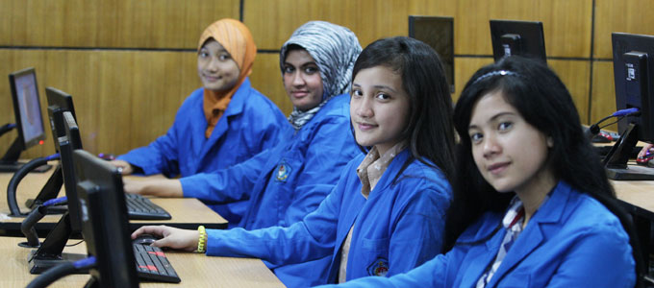

Information and Communication Technology
PROFIL
FACILITIES & SERVICES
HARDWARE
SOFTWARE
HUMANWARE

Slide 8
Information and Communication Technology
PROFIL
ICT Centre of Bosowa 45 University Makassar is located at JL. Urip Sumoharjo Km. 4 Makassar. ICT centre of Bosowa 45 University Makassar is a support Centre that provides and facilitates ICT services to the students, lectures, and staffs in University of Bosowa 45 Makassar. Activities that have been hold in ICT centre of Bosowa 45 University Makassar are : the development of service access, intranet and internet , the development of Academic Information Systems , And the improvement of academic staff ability in upgrading teaching material relate to ICT –Based on Learning Media, e -journal and e – library
FACILITIES & SERVICES
HARDWARE
SOFTWARE
HUMANWARE

Slide 9
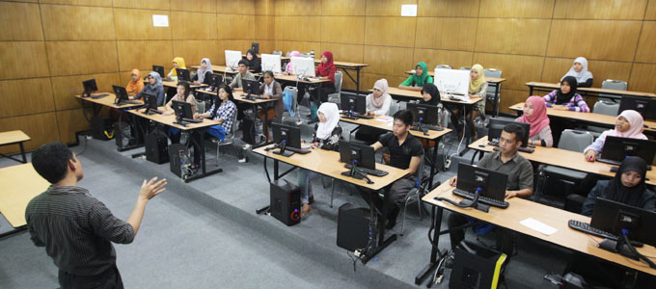
Information and Communication Technology
Facilities
Computer Laboratory
PROFIL
FACILITIES & SERVICES
HARDWARE
SOFTWARE
HUMANWARE

Slide 10
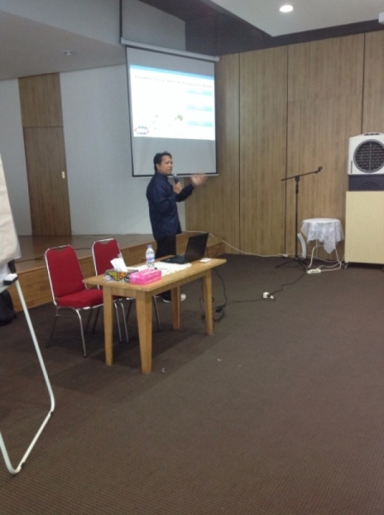
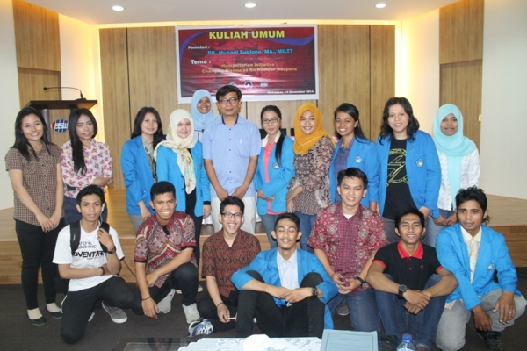
Information and Communication Technology
Service
Training for ICT Development
PROFIL
FACILITIES & SERVICES
HARDWARE
SOFTWARE
HUMANWARE

Slide 11
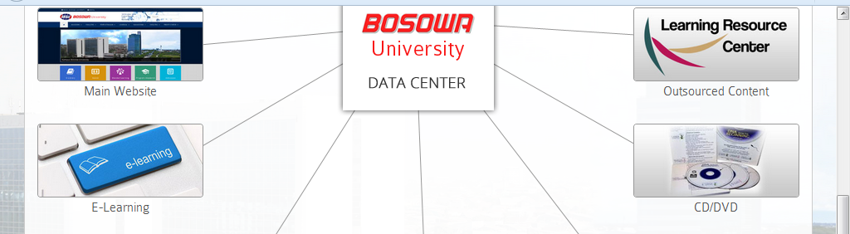
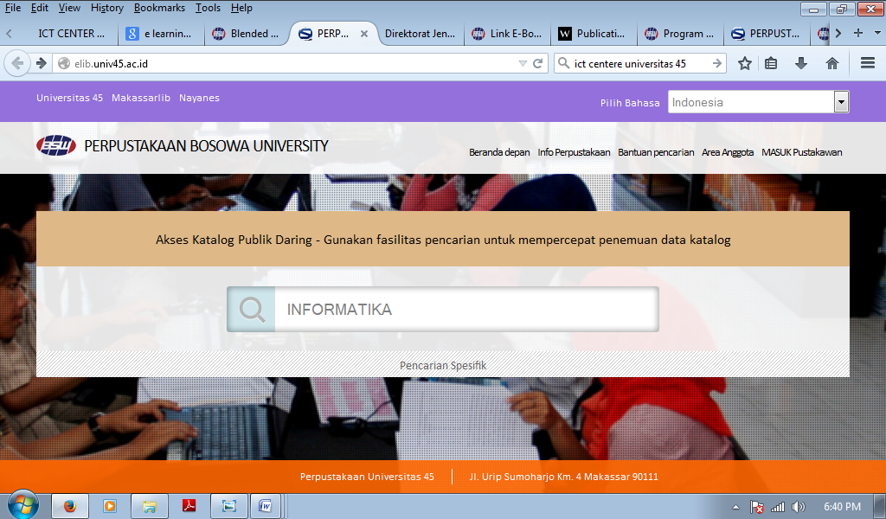
Information and Communication Technology
Service
E learning, E-library
PROFIL
FACILITIES & SERVICES
HARDWARE
SOFTWARE
HUMANWARE

Slide 12
Information and Communication Technology
HARD WARE
PROFIL
No | Hardware | Amount
1 | Computer (PC) | 18 Units
2 | Laptop | 2 units
3 | LCD Projector | 3 units
4 | Printer | 3 units (canon)
5 | LAN
6 | TV | 1 (sharp)
7 | Speaker | 2
8 | Scanner | 1 Canon
12 | Wifi | 20 mbps
FACILITIES & SERVICES
HARDWARE
SOFTWARE
HUMANWARE

Slide 13
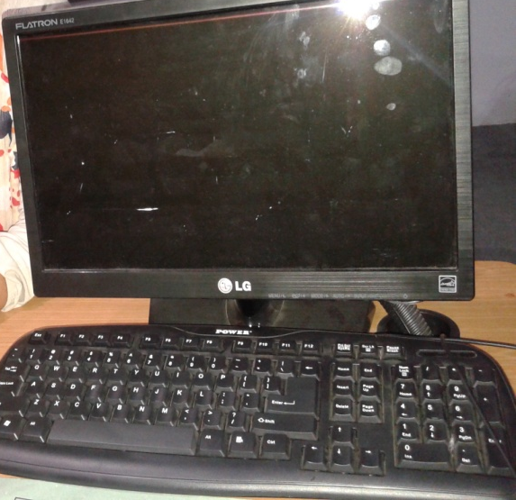
Information and Communication Technology
HARD WARE
PROFIL
FACILITIES & SERVICES
HARDWARE
SOFTWARE
20 units LG Flatron E1642 (16 inch)
HUMANWARE

Slide 14
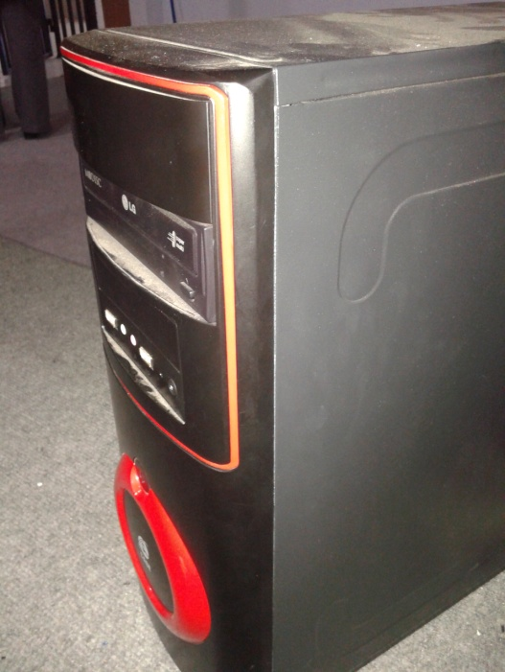
Information and Communication Technology
HARD WARE
PROFIL
FACILITIES & SERVICES
HARDWARE
SOFTWARE
CPU
Processor : Dualcore INTEL PENTIUM G630
RAM : 2 GB
DVD ROM
HUMANWARE

Slide 15
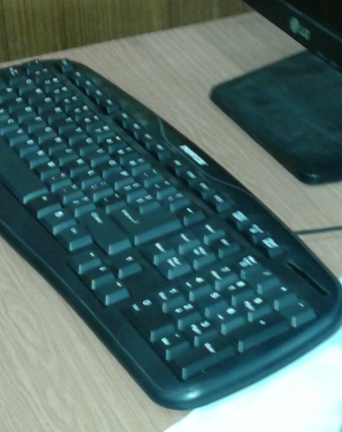
Information and Communication Technology
HARD WARE
PROFIL
FACILITIES & SERVICES
HARDWARE
SOFTWARE
KEYBOARD
HUMANWARE

Slide 16
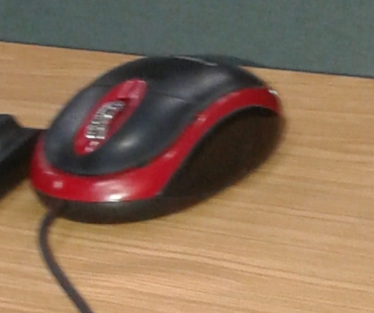
Information and Communication Technology
HARD WARE
PROFIL
FACILITIES & SERVICES
HARDWARE
SOFTWARE
MOUSE
HUMANWARE

Slide 17
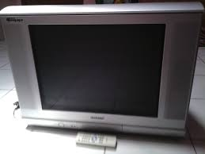
Information and Communication Technology
HARD WARE
PROFIL
FACILITIES & SERVICES
HARDWARE
SOFTWARE
1 TV
SHARP
HUMANWARE

Slide 18
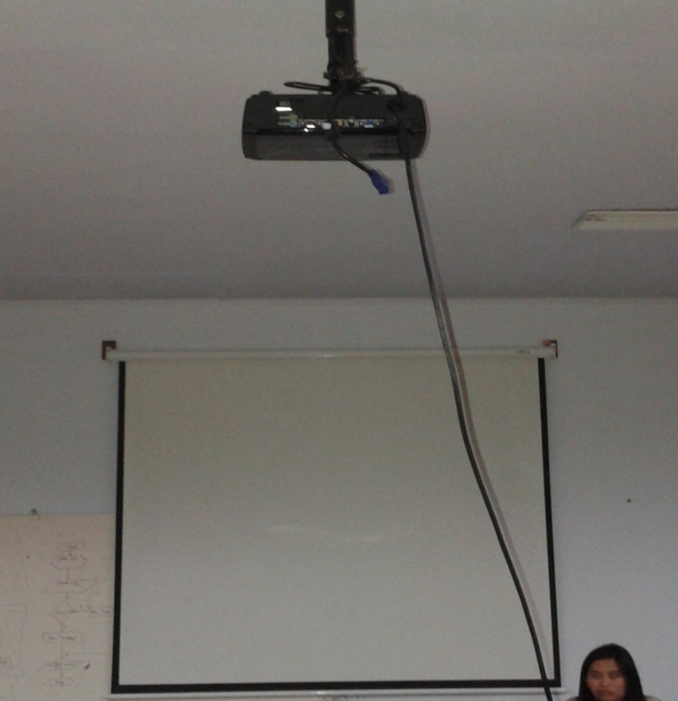
Information and Communication Technology
HARD WARE
PROFIL
FACILITIES & SERVICES
HARDWARE
SOFTWARE
HUMANWARE
3 LCD PROJECTOR

Slide 19
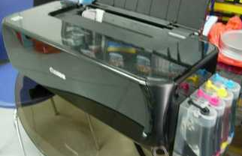
Information and Communication Technology
HARD WARE
PROFIL
FACILITIES & SERVICES
HARDWARE
SOFTWARE
3 PRINTER
CANON IP2770
HUMANWARE

Slide 20
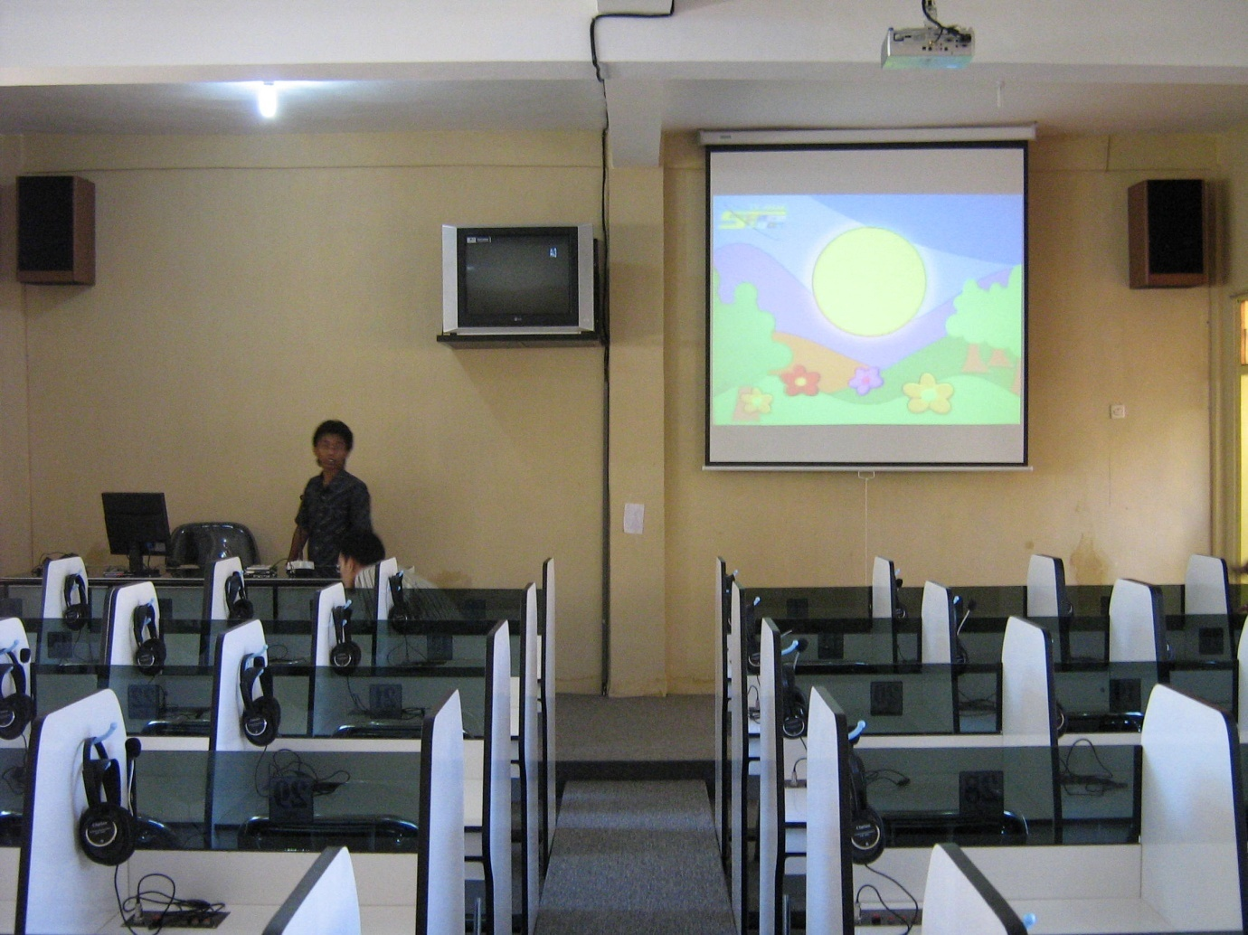
Information and Communication Technology
HARD WARE
PROFIL
FACILITIES & SERVICES
HARDWARE
SOFTWARE
2 SPEAKER
HUMANWARE

Slide 21
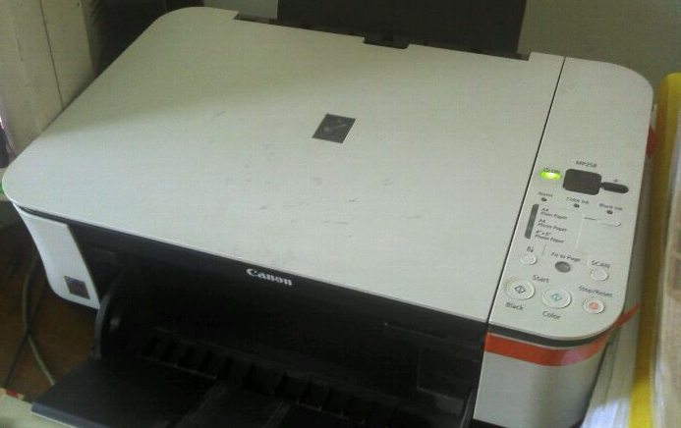
Information and Communication Technology
HARD WARE
PROFIL
FACILITIES & SERVICES
HARDWARE
SOFTWARE
2 SCANNER
HUMANWARE

Slide 22

Information and Communication Technology
SOFT WARE
FOR DESIGN
COREL DRAW 16
PROFIL
a vector graphics editor . It is also the name of Corel's Graphics Suite, which bundles CorelDraw with a bitmap image editor, corel photo-paint and other graphics-related programs
FACILITIES & SERVICES
HARDWARE
SOFTWARE
HUMANWARE

Slide 23
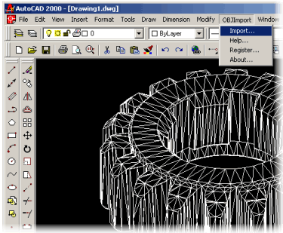
Information and Communication Technology
SOFT WARE
FOR DESIGN
Auto Cad
PROFIL
FACILITIES & SERVICES
a commercial software application for 2D and 3D computer-aided design (CAD)
HARDWARE
SOFTWARE
HUMANWARE

Slide 24
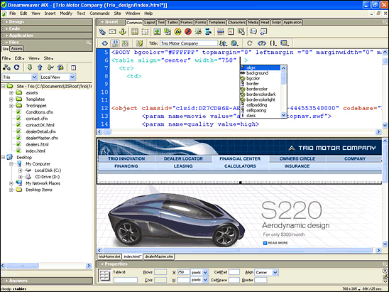
Information and Communication Technology
SOFT WARE
FOR DESIGN
Adobe Dream weaver
PROFIL
FACILITIES & SERVICES
A proprietary web development tool developed by Adobe systems.
HARDWARE
SOFTWARE
HUMANWARE

Slide 25
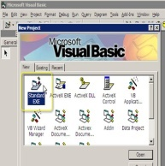
Information and Communication Technology
SOFT WARE
FOR PROGRAMMING
Visual Basic
PROFIL
With visual Basic A programmer can create an application using the components provided by the Visual Basic program itself
FACILITIES & SERVICES
HARDWARE
SOFTWARE
HUMANWARE

Slide 26
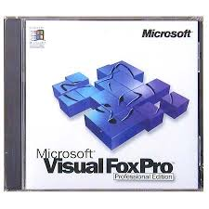
Information and Communication Technology
SOFT WARE
FOR PROGRAMMING
Fox Pro
PROFIL
a text-based procedurally printed programming language and DBMS, and it is also an object-oriented software programming
FACILITIES & SERVICES
HARDWARE
SOFTWARE
HUMANWARE

Slide 27
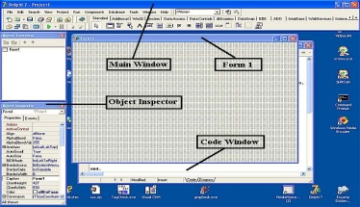
Information and Communication Technology
SOFT WARE
FOR PROGRAMMING
Delphi
PROFIL
FACILITIES & SERVICES
Delphi includes facilities for rapidly building or converting an application into a Web service.
HARDWARE
SOFTWARE
HUMANWARE

Slide 28
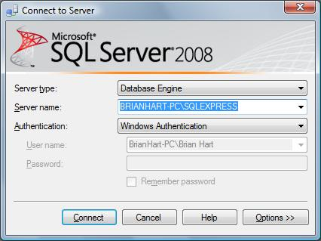
Information and Communication Technology
SOFT WARE
FOR PROGRAMMING
Structured Query Language (SQL)
PROFIL
FACILITIES & SERVICES
a special- purpose programming language designed for managing data held in a relational database management systemr(RDBMS), or for stream processing in a relational data stream management system (RDSMS).
HARDWARE
SOFTWARE
HUMANWARE

Slide 29
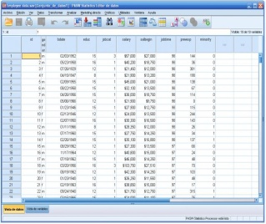
Information and Communication Technology
SOFT WARE
FOR APPLICATION PROGRAM
SPSS
PROFIL
FACILITIES & SERVICES
a widely used program for statistical analysis in social science. It is also used by market researchers, health researchers, survey companies, government, education researchers, marketing organizations, data miners, and others.
HARDWARE
SOFTWARE
HUMANWARE

Slide 30
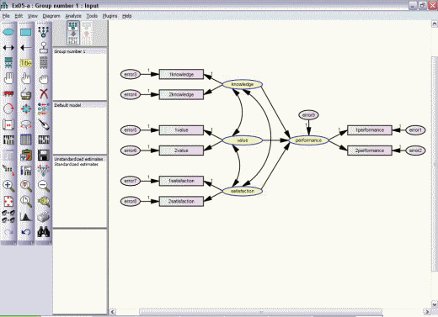
Information and Communication Technology
SOFT WARE
FOR APPLICATION PROGRAM
AMOS
PROFIL
FACILITIES & SERVICES
statistical software and it stands for analysis of a moment structures
HARDWARE
SOFTWARE
HUMANWARE

Slide 31

Information and Communication Technology
SOFT WARE
FOR APPLICATION PROGRAM
LISREL
PROFIL
An acronym for linear structural relations, is a statistical-software package used in structural equation modeling (SEM) for manifest and latent variables.
FACILITIES & SERVICES
HARDWARE
SOFTWARE
HUMANWARE

Slide 32

Information and Communication Technology
SOFT WARE
FOR APPLICATION PROGRAM
MICROSOFT OFFICE
PROFIL
An office suite of desktop application, servers and services for Microsoft windows OS X Operation system
FACILITIES & SERVICES
HARDWARE
SOFTWARE
HUMANWARE

Slide 33
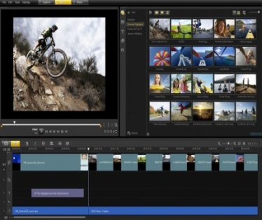
Information and Communication Technology
SOFT WARE
FOR APPLICATION PROGRAM
Corel Video Studio
PROFIL
FACILITIES & SERVICES
a video editing software package for windows.
HARDWARE
SOFTWARE
HUMANWARE

Slide 34
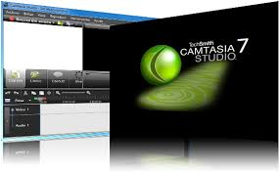
Information and Communication Technology
SOFT WARE
FOR APPLICATION PROGRAM
Camtasia Studio and Camtasia for Mac
PROFIL
FACILITIES & SERVICES
software suites for creating video tutorials and
presentations directly via screen cast, or via a direct recording plug-in to Microsoft Power Point
HARDWARE
SOFTWARE
HUMANWARE

Slide 35
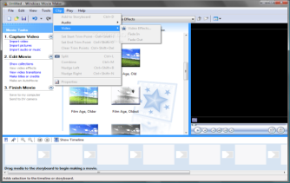
Information and Communication Technology
SOFT WARE
FOR APPLICATION PROGRAM
Movie Maker
PROFIL
FACILITIES & SERVICES
a software that allows you to create and edit videos
HARDWARE
SOFTWARE
HUMANWARE

Slide 36
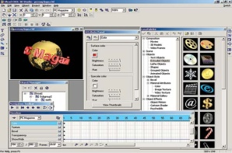
Information and Communication Technology
SOFT WARE
FOR APPLICATION PROGRAM
ULEAD A
PROFIL
FACILITIES & SERVICES
multimedia software in various areas such as video editing, media management, web utility, DVD authoring and digital home
HARDWARE
SOFTWARE
HUMANWARE

Slide 37
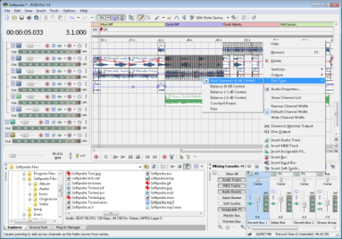
Information and Communication Technology
SOFT WARE
FOR APPLICATION PROGRAM
ACID PRO
PROFIL
FACILITIES & SERVICES
a professional digital audio workstation (DAW) software program.
HARDWARE
SOFTWARE
HUMANWARE

Slide 38
Information and Communication Technology
HUMAN WARE
HEAD OF LABORATORY
PROFIL
No | Humanware | Amount
1 | Head of laboratory | 1
2 | Laboratory assistant | 2
3 | Secretary | 1
4. | Technician
5. | Lecturer
FACILITIES & SERVICES
HARDWARE
SOFTWARE
HUMANWARE

Slide 39
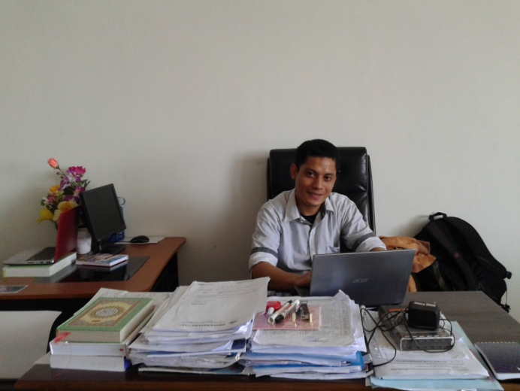
Information and Communication Technology
HUMAN WARE
HEAD OF LABORATORY
PROFIL
FACILITIES & SERVICES
HARDWARE
SOFTWARE
HUMANWARE

Slide 40

Information and Communication Technology
HUMAN WARE
STAFF/LECTURER
PROFIL
FACILITIES & SERVICES
HARDWARE
SOFTWARE
HUMANWARE

Slide 41
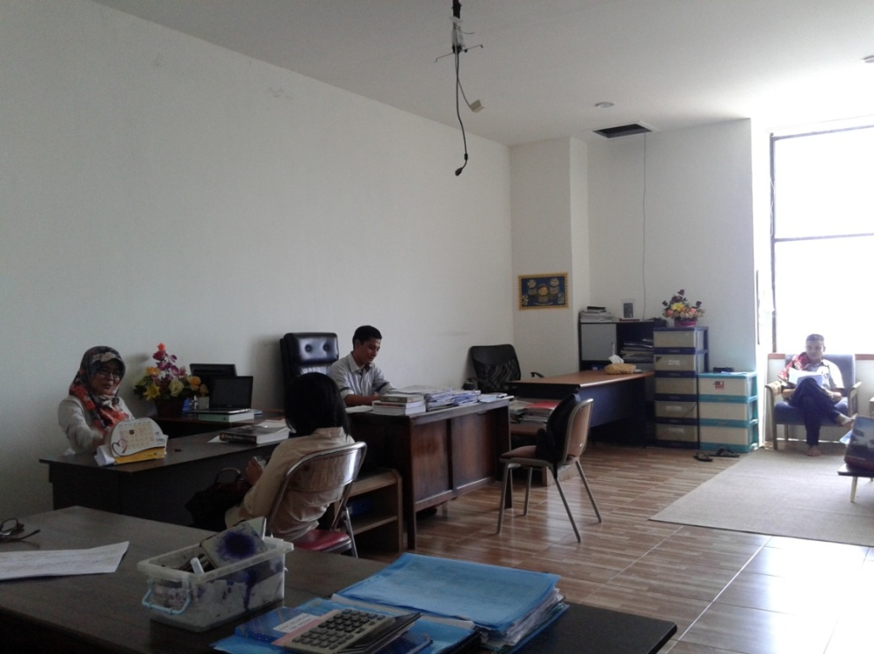
Information and Communication Technology
HUMAN WARE
ICT CENTRE OFFICE
PROFIL
FACILITIES & SERVICES
HARDWARE
SOFTWARE
HUMANWARE

