Slide 1

VISITATION ON ICT FACILITATION
INFORMATION AND TECHNOLOGYCOMMUNICATION
MUCHLIS 13B01135
SULFIANA 13B01137
MIFTAHUL JANNAH 13B01139
ASFIAH SYAM 13B01144
FERI FEBRIARI 13B01166
JUMARNI 11B01159

Slide 2

Introduction
Profile of facility center
Discussion
Details of ware
Conclusion

Slide 3





Introduction
HUMAN NEEDS
food, house, and cloth
the information and communication

Slide 4

All the technical equipments for processing and conveying information
Communication technology
Information technology
INFORMATION AND COMMUNICATION TECHMNOLOGY

Slide 5



Information and communication technology is currently applied in education to accelerate the educational process. Many teachers use ICT facilitation to help them deliver the material in language teaching and learning process. Even the school equips the teachers and students with computer lab so both teacher and students can utilize ICT in education process

Slide 6


Profile of facility center
SMA Negeri 1 Marioriwawo
Located in Marioriwawo Sub-district, Soppeng District, at Jl.Guru Mollong.
Established in 1989
Starting to equip the school with ICT facilitation since 2011
Recorded in the Learning Resource Center (PSB) in 2011 with Moodle LMS as the main controller. The content consists of Online Assignment (55 pieces), Chat (6 pieces), Options (questionnaire) (12 pieces), the topic of discussion (66 pieces), label (104), quizzes (155), Reading (400).
In 2012 till now LMS Moodle at SMAN 1 Marioriwawo has become the prevailing trend of online learning as the main medium of learning in SMAN 1 Marioriwawo

Slide 7


Details of ware
List of HARDWARE in SMAN1 Marioriwawo
No | Hardware | Amount
1 | Computer (PC) | 20 Units
2 | Laptop | 5 Units
3 | LCD | 7 Units (ACER)
4 | Printer | 5 Units (Canon and HP)
5 | LAN | In every rooms in the school
6 | CCTV/TV | 12 Units/2 units
7 | Speaker | 4 units
8 | Scanner | 1 (HP)
9 | Finger Scanner | 2 units
10 | Private Laptop | Most of the teacher has their own laptop
11 | Wifi | 5 unit

Slide 8

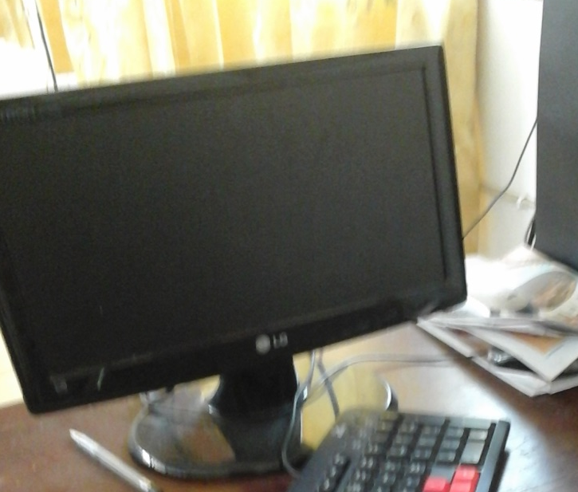
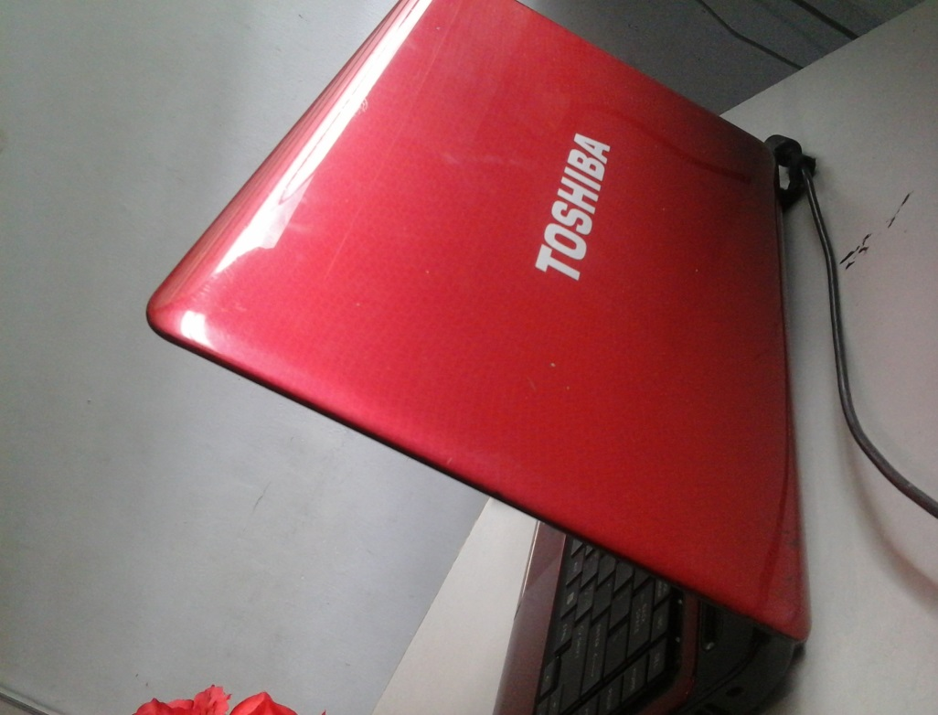

Hardware
PC (LG Flatron, 16”)
Laptop (Toshiba)

Slide 9

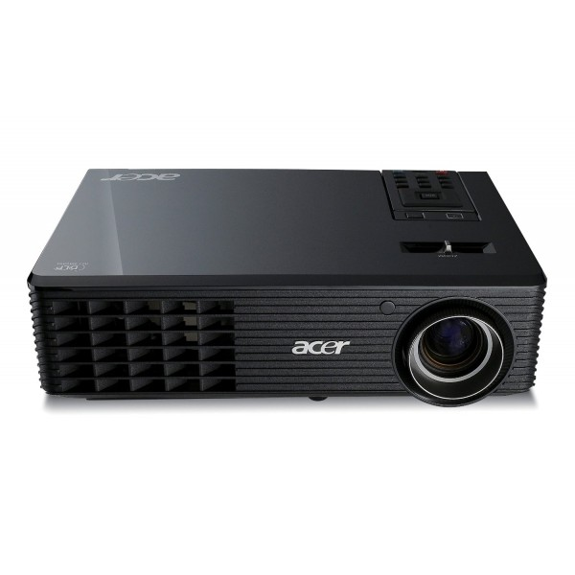
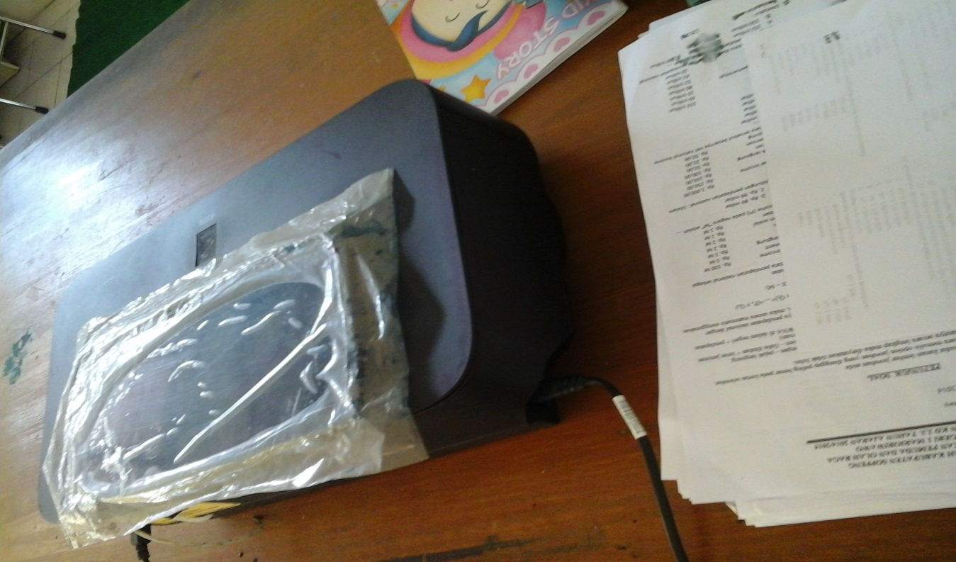
LCD (ACER)
Printer (Canon)

Slide 10


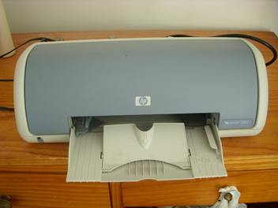
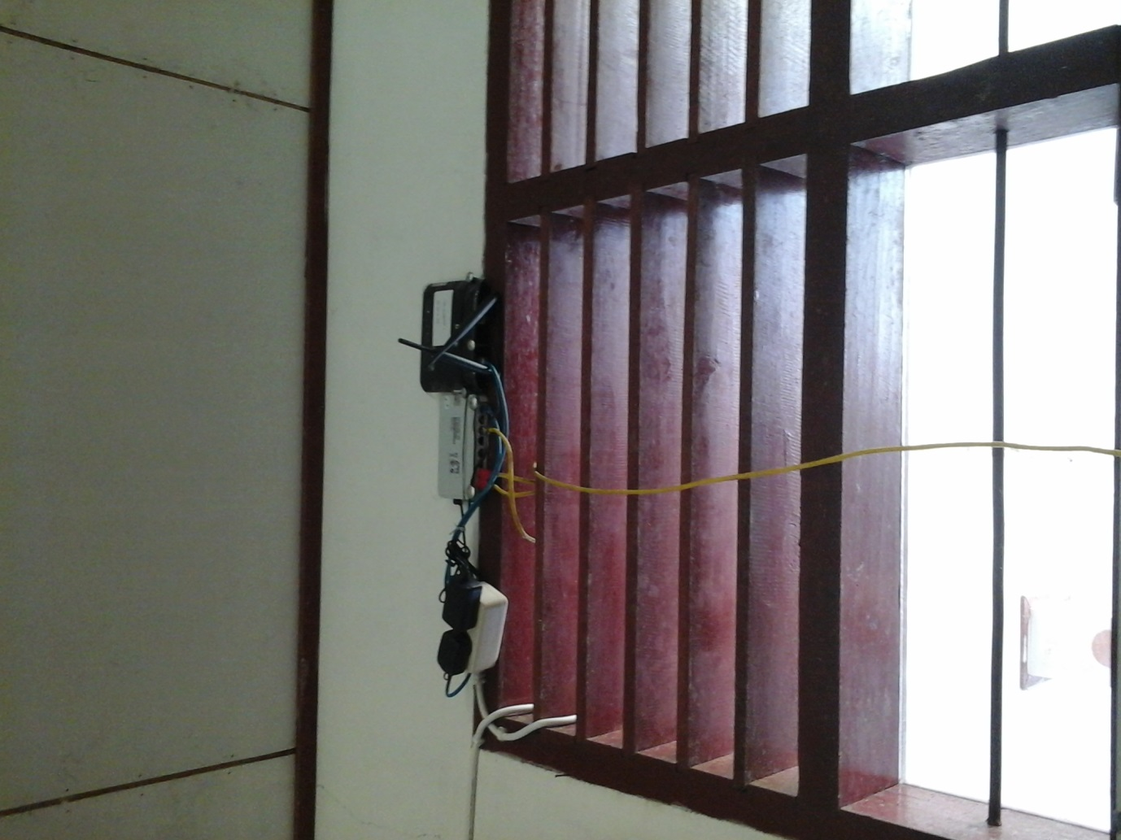
PRINTER (HP)
LAN

Slide 11

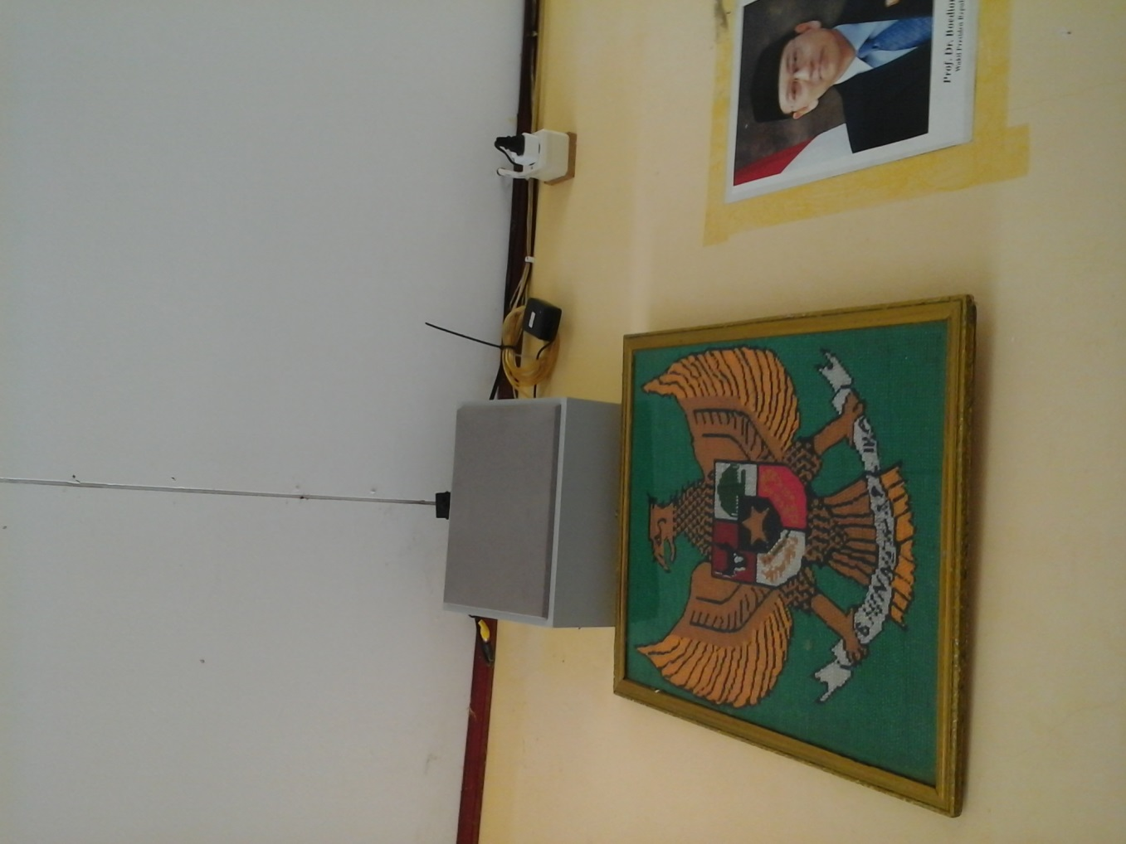
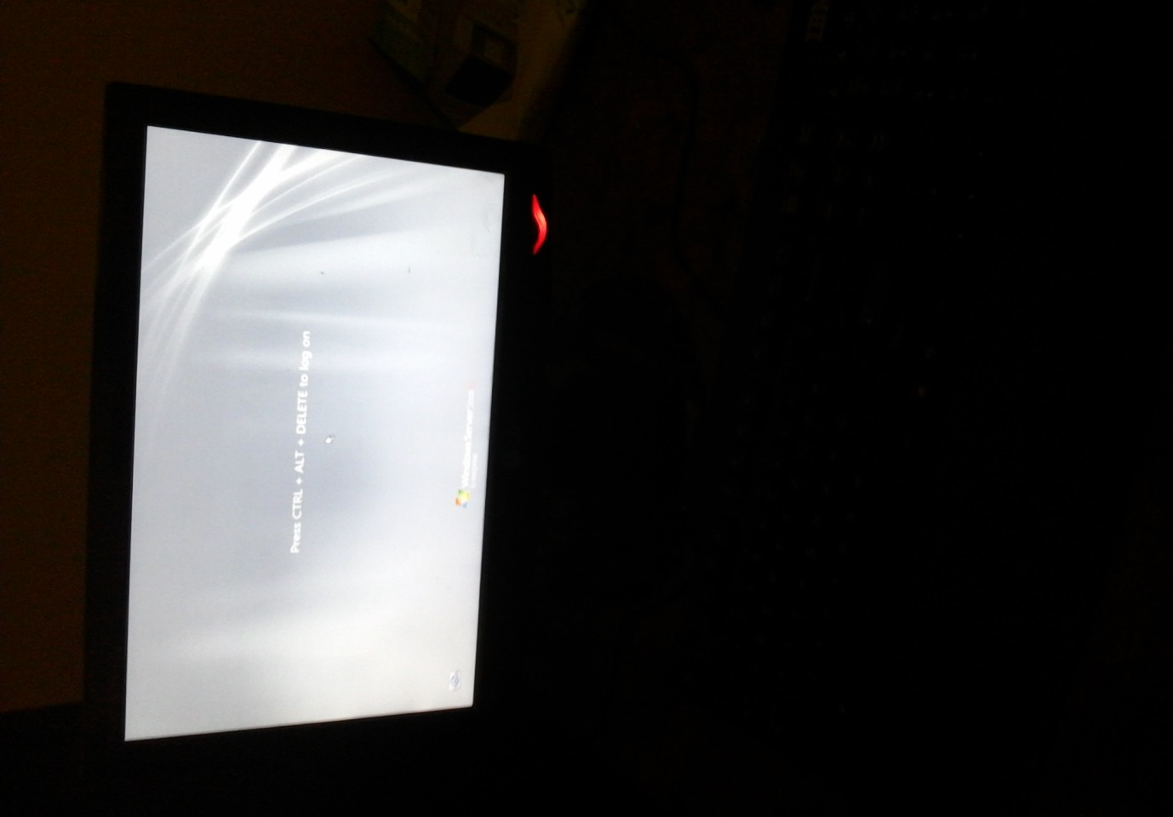
CCTV
TV Monitor for CCTV

Slide 12


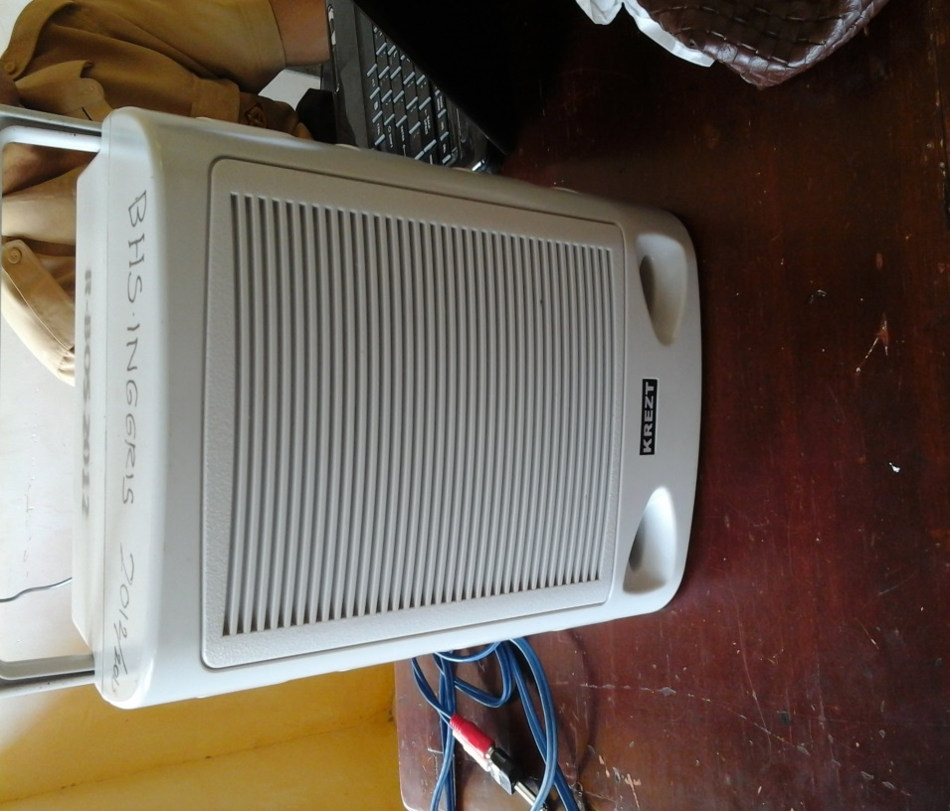
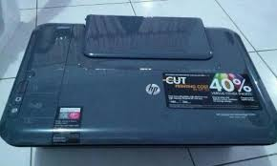
SPEAKER
SCANNER (HP)

Slide 13

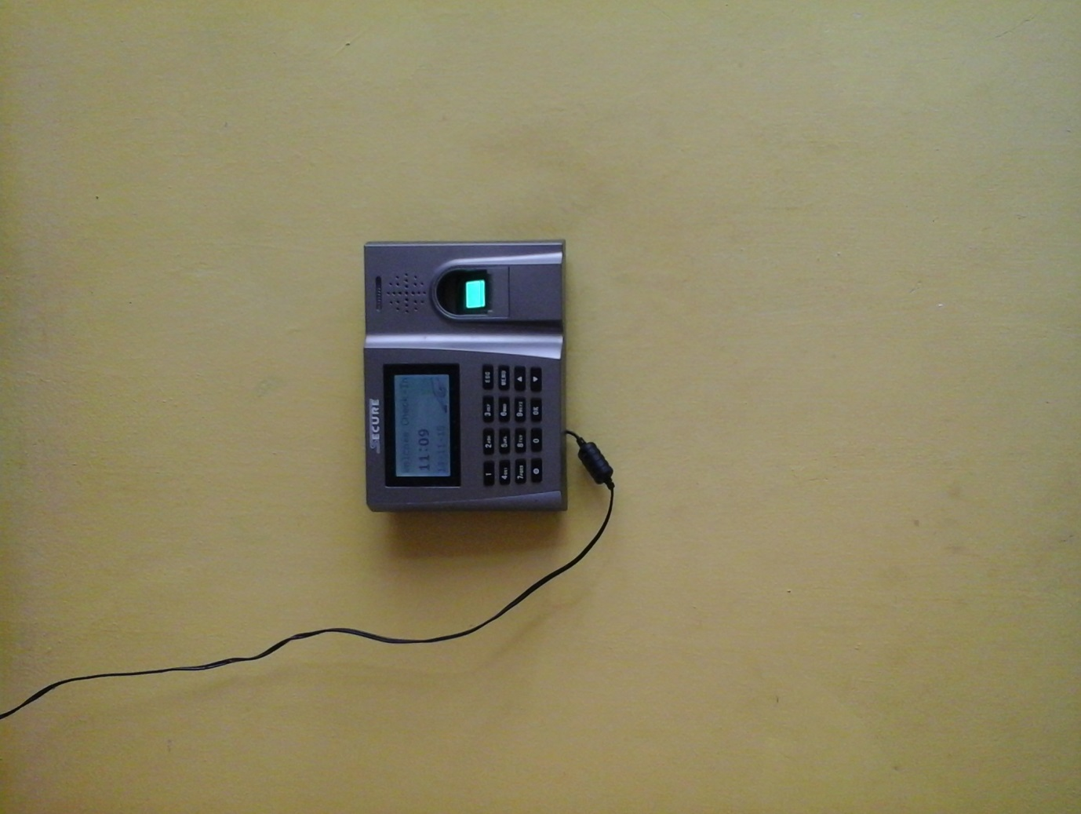
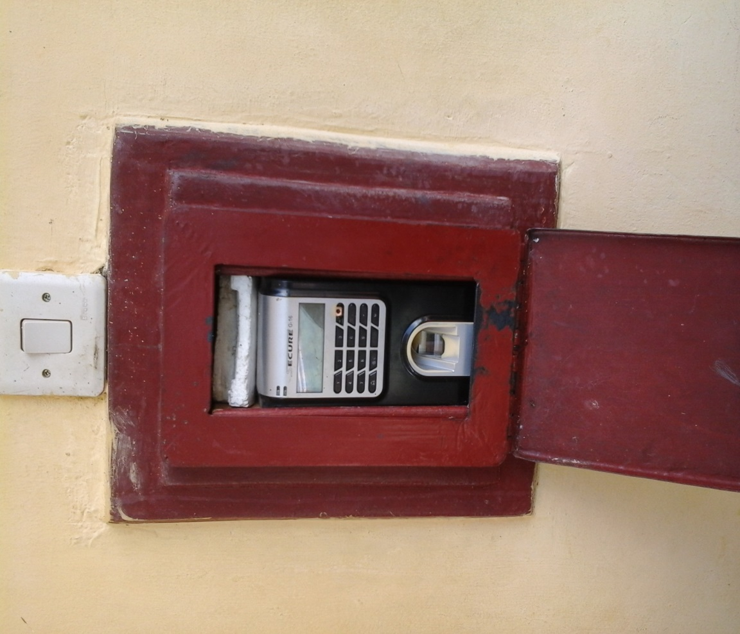
FS for teacher
FS for students

Slide 14


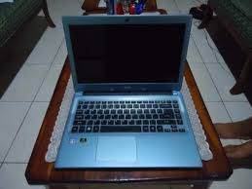
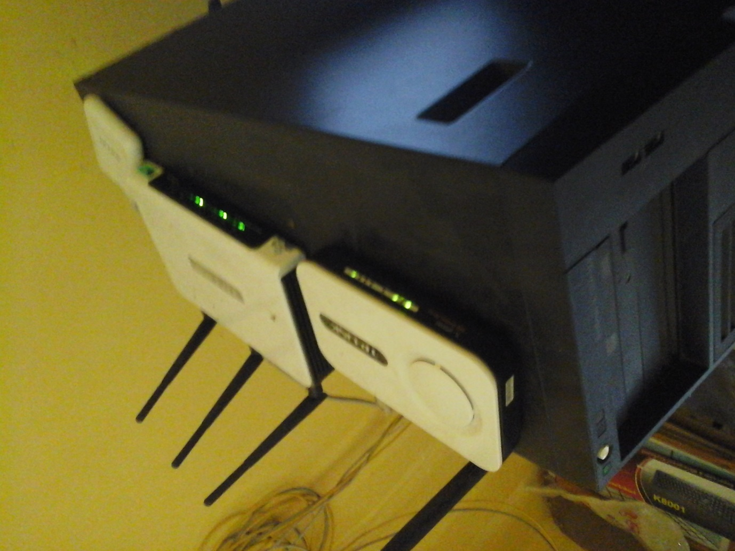
Teacher’s privat laptop
Wifi (modem)

Slide 15


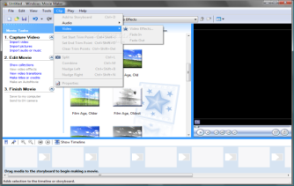
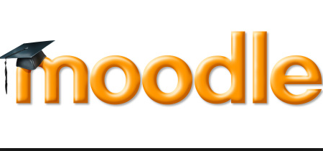
List of SOFTWARE in SMAN 1 Marioriwawo
Software for Application and Programming
No | Software | Description | Pictures
1 | Microsoft Office | An office suite of desktop applications, servers and services for Microsoft Windows and OS X operating systems
2 | Movie Maker | A software that allows you to create and edit videos
3 | XAMPP folder and moodle | XAMPP is a fully functional web server package. It is bulit to test web based programs on a personal computer.

Slide 16

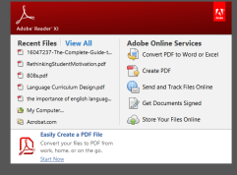
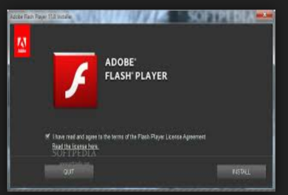
No | Software | Description | Pictures
4 | Adobe reader 11.0.10 | Family of application software and web services developed by adobe System to view, create, manipulate, print and manage file in portable Document Format (PDF)
5 | Flashplayer 16.0.0.235 | Freeware software for viewing multimedia, executing rich internet application, and streaming video and audio, content created on the Adobe Flash Platform

Slide 17

List of HUMANWARE in SMAN 1 Marioriwawo
No | Human Resources | Number
1 | Operator | 3 operators (Herfiana, Dewi Ramadani, Asma)
2 | Technician | 1 person
3 | ICT teachers | 2 teachers (syarif and Taufiq
4 | Vice Principal (Person in charge) | 6 persons
5 | Person in charge for PSB (Pusat Sumber Belajar) | 1 person
6 | Students and Teachers | 278 Students and 28 teachers

Slide 18

Conclusion
SMAN 1 Marioriwawo can be cotegorized as good. The school supports the teachers and the students with sufficient number of ICT facilities. Daily examination of the students and teaching materials are all prepared in moodle. Hence, the students can learn anytime, especially during working on their tasks, mid-test and final test. Everything is done throiugh online system.

Slide 19




