Slide 1


Slide 2


Slide 3


Slide 4
INFORMATION AND COMMUNICATION TECHNOLOGY (ICT) IN ISLAMIC STATE UNIVERSITY (UIN) ALAUDDIN MAKASSAR
BY
(Group 3)
ILHAM
NUNUNG ARDIANSA
NURJANNAH
RUSDIYAH
MUSFIRAH

Slide 5

Profile
HARDWARE
SOFTWARE
HUMANWARE

Slide 6

History of Pustipad UIN Alauddin Makassar
Center for Information and Computer UIN Alauddin Start Perceived formation in 1995 , starting from Computer Training in laboratory First -Training UIN Alauddin on Campus I , Jl . Sultan Alauddin 63 , Makassar . on 1997 the ICT center of UIN Alauddin called Puskom, but in 2009 until now the name was changed ‘PUSTIPAD’.during the month of November 2009 , the new State Officials was Mr. Ridwan Andi Kambau Which is a lecturer of Information ( TI ) in the Faculty of Science and Technology UIN Alauddin .

Slide 7

Vision and mission
Vision
Being the center of the data service and the best information that provide operational support work in the field of education , research , and community service through the utilization of information technology refers to the vision and mission of UIN Alauddin "

Slide 8

Cont….
Mission
Collecting and managing information resources University
Providing Integrated Management Information System University
Controlling and coordinating the resource users of information and communication technology
Providing computer network connectivity internally and externally .
Implementing Internal Management based Information and Communication Technology

Slide 9

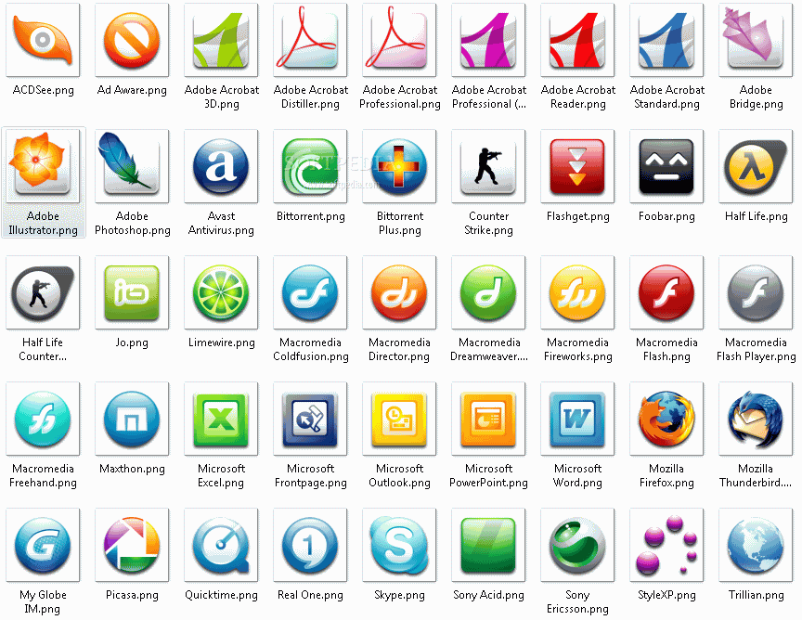

ASPECT OF ICT IN UIN ALAUDDIN MAKASSAR
HARDWARE
SOFTWARE
HUMANWARE

Slide 10
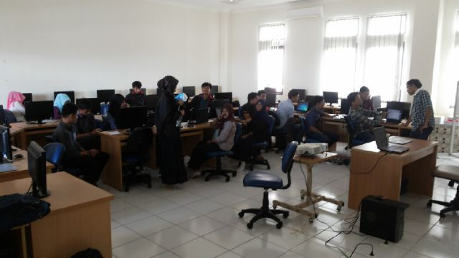
HARDWARE
Basic programming Laboratory (Laboratorium Pemograman dasar)
There are 32 units computer

Slide 11
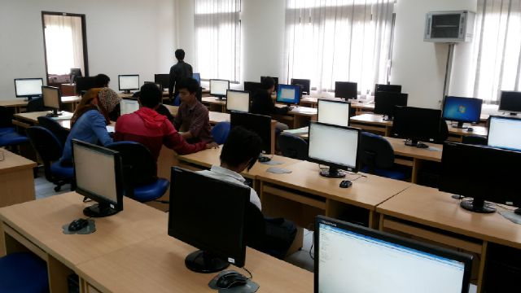
HARDWARE
Advanced Programming Laboratory (Laboratorium Pemograman Lanjutan)
There are 30 units computer

Slide 12
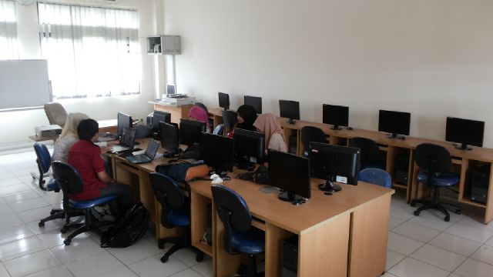
HARDWARE
Robotic and Microsofisor Laboratory (Laboratorium Robotika dan Microsofisor)
There are 14 units computer

Slide 13
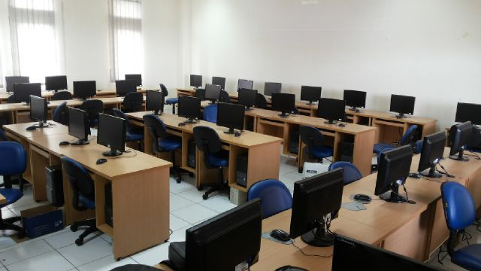
HARDWARE
Basic Informatics Laboratory (Laboratorium Informatika Dasar)
There are 40 units computer

Slide 14
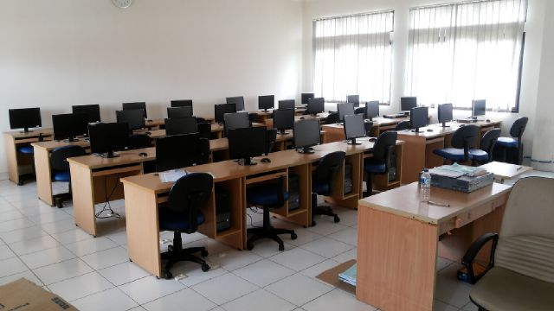
HARDWARE
Computer Network Laboratory (Laboratorium Komputer Jaringan)
There are 28 units computer

Slide 15
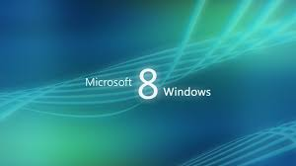
SOFTWARE
Based on our observation of hardware that UIN Alauddin, each computer there uses windows 8
Windows 8 is a personal computer operating system developed by Microsoft as part of the Windows NT family of operating systems. Development of Windows 8 started before the release of its predecessor, Windows 7. in 2009.

Slide 16
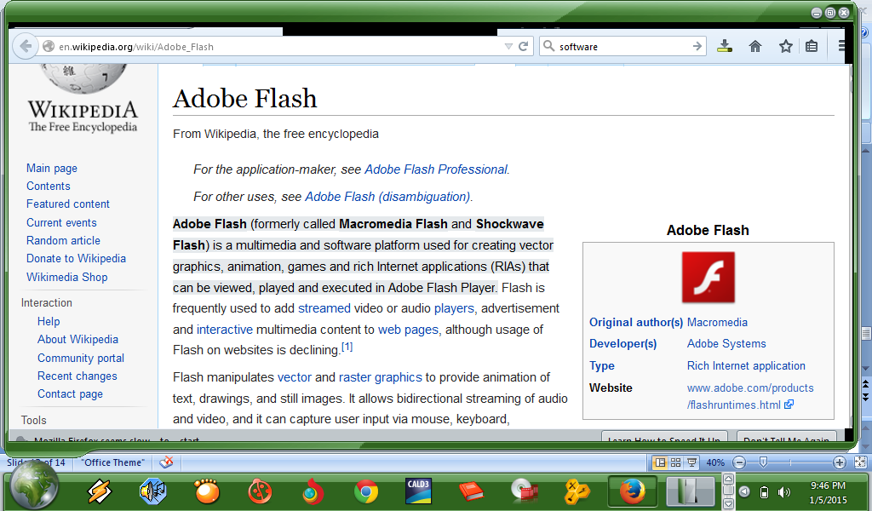
Adobe Flash (formerly called Macromedia Flash and Shockwave Flash) is a multimedia and software platform used for creating vector graphics,animation, games and rich internet aplications (RIAs) that can be viewed, played and executed in adobe flash player.

Slide 17
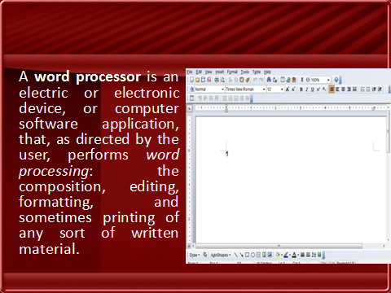

Slide 18

Microsoft Office is an office suite of desktop applications, servers and services for Microsoft windows and OS X operating systems.

Slide 19
HUMANWARE
There one chief for five laboratories, his name is Asrarul Ikram, S.kom. Each laboratory has their own staff as the one who responsible one.
  The lectures who teach in laboratories are :
Faisal, ST., MT
Drs. Kamaruddin Tone., MM
Faisal ., S.Kom., M.Kom.
Mustikasari., S.Kom., M.Kom

Slide 20
Cont…
5. Rindwan Andi Kambau., ST., M.Kom
6. Yusran Bohibu., S, Kom., M.Kom
7. Farida Yusuf., S.Kom., MT
8. Sri Wahyuni., S.Kom., MT
Each lecture based on their major to teach their subject

Slide 21


