Slide 1
VISITING ICT CENTRE
UNIVERSITAS MUHAMMADIYAH MAKASSAR
GROUP MEMBERS
BESSE FATWA ILMI ( 13B01138)
SAMSINAR ( 13B01147)
JELITA PURNAMASARI ( 13B01149)
ANDI SURYA PRADANINGRAT ( 13B01154)
MUHAMMAD ZIAUL HAQ ( 13B01155)

Slide 2
OUTLINE
Introduction
Hardware
Software
Humanware

Slide 3
Today computer is available in many offices and homes and therefore there is a need to share data and programs among various computers with the advancement of data communication facilities (Jamalil, Hafizat. 2011: 1-Chicablogger.com).
Information and Communication Technology (ICT) can contribute to universal access to education, equity in education, the delivery of quality learning and teaching, teachers’ professional development.
Educational technology includes numerous types of media that deliver text, audio, images, animation, and streaming video, and includes technology applications and processes such as audio or video tape, satellite TV, CD-ROM, and computer-based learning, as well as local intranet/extranet and web-based learning.

Slide 4
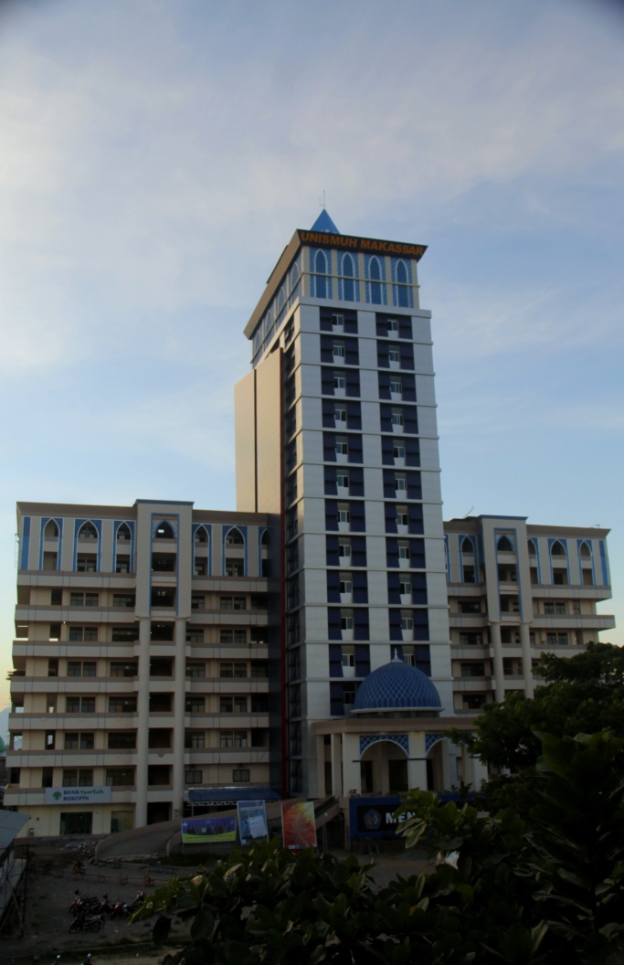
INTRODUCTION
ICT Centre in 2005
Located in UNISMUH
Makassar
South Sulawesi
Indonesia

Slide 5
HARDWARE
The term hardware refers to the tangible parts of a computer system, that is, the physical equipment of the computer.
In UNISMUH ICT centre provides PC, LCD, monitor, printer, headphone, etc.

Slide 6
No | Hardware | Number | Specification
1 | Computer (PC)/CPU | 1 Unit | Core i3, RAM 2 GB, VGA invidia (Dell Build Up)
2 | speaker | 2 Unit | Simbadda-proton
3 | LCD | 1 Unit | Epson
4 | Printer | 1 Unit | Canon Laserjet
5 | Monitor | 1 Unit | LG, 17 inch
6 | Headphone | 30 units | A-Tech
7 | Mouse | 1 unit | A-Tech
8 | Sound Cable | 30 units | -
9 | screen | 1 unit | Epson
10 | Flash Disk | 1 unit | Toshiba
11 | LAN / Wi-Fi

Slide 7
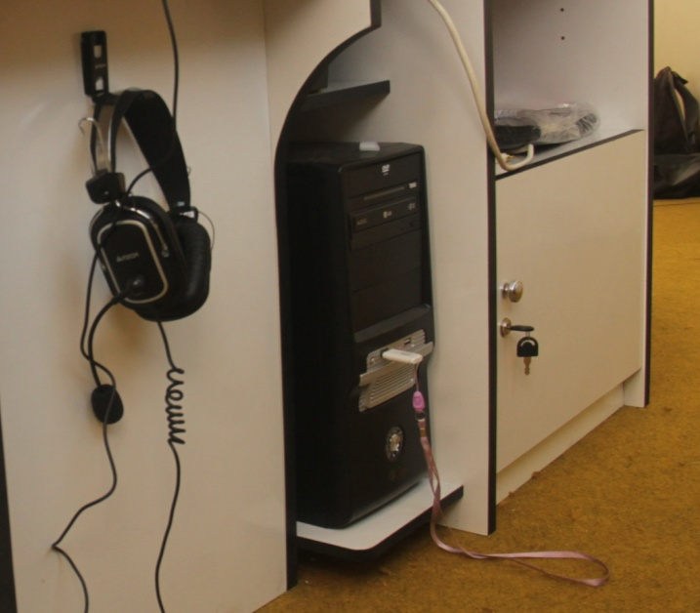
CPU

Slide 8
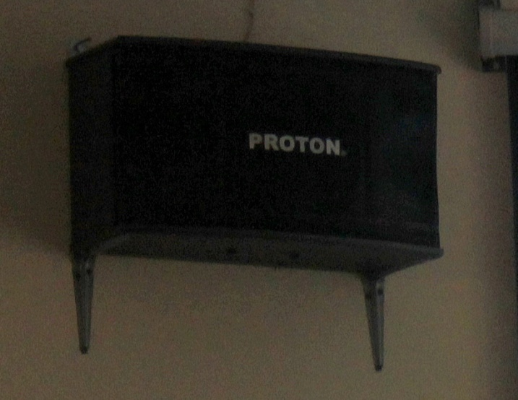
Speaker

Slide 9
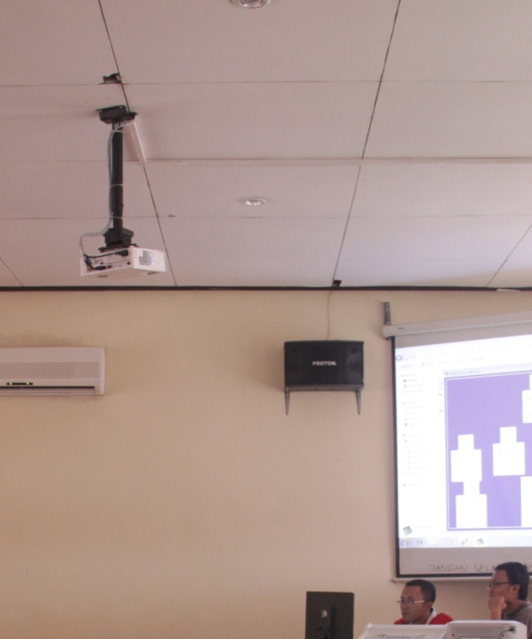
LCD Projector

Slide 10
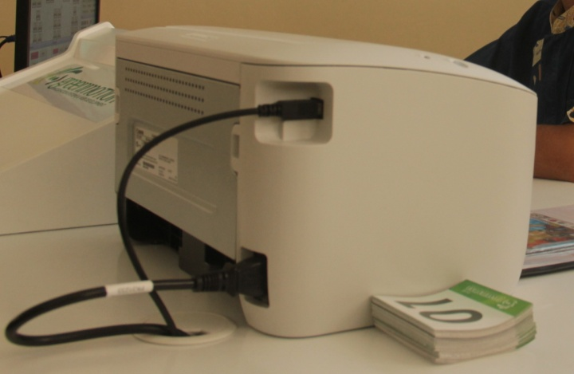
Printer

Slide 11
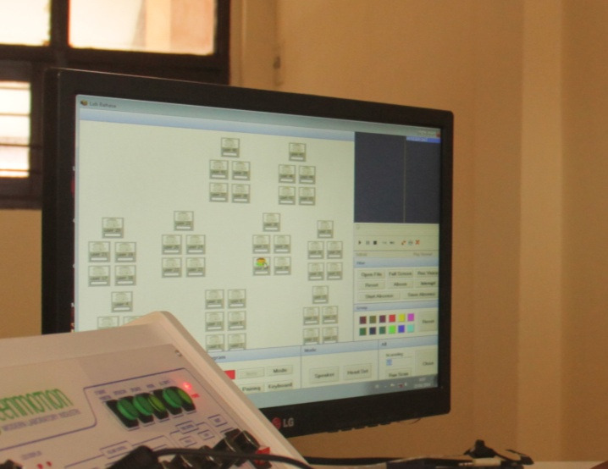
Monitor

Slide 12
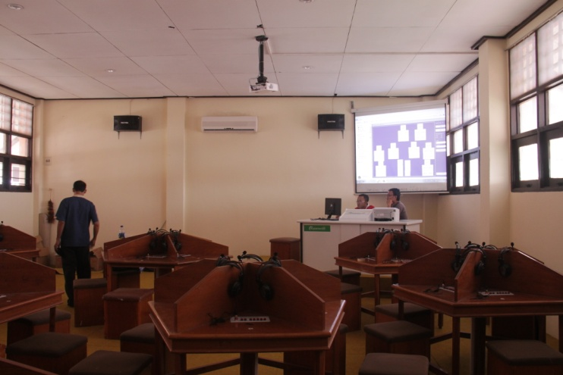
Headphones

Slide 13
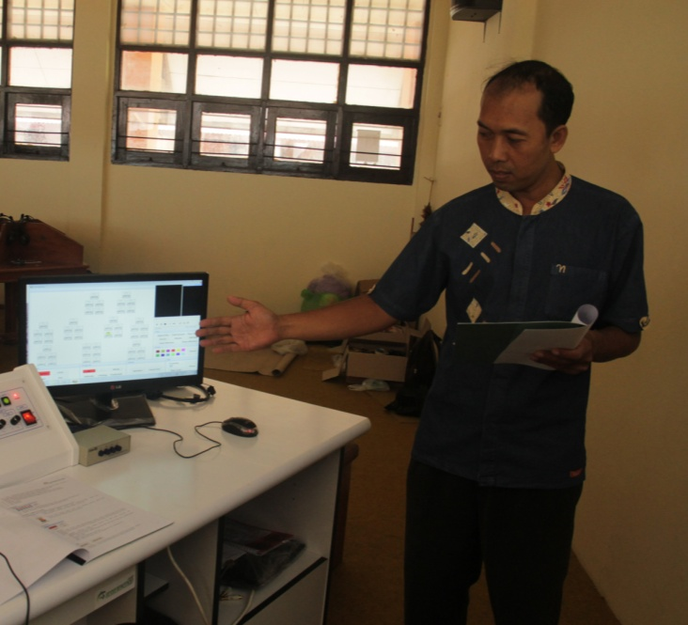
Mouse

Slide 14
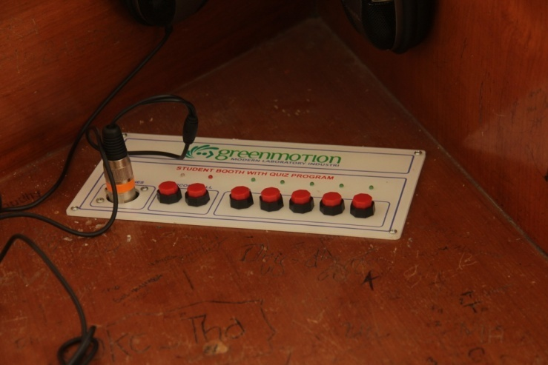
Sound Cable

Slide 15
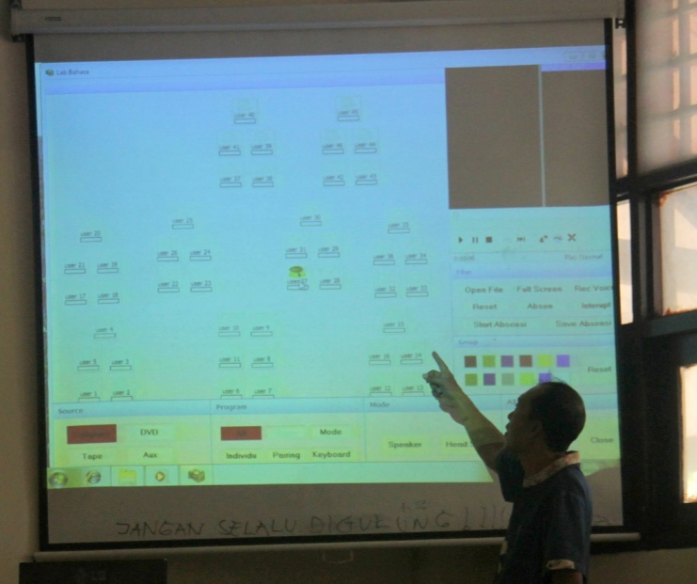
Screen

Slide 16
Flash Disk

Slide 17
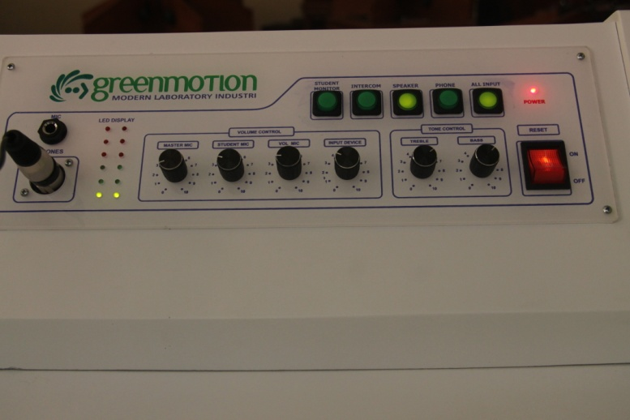
Green Motion Hardware

Slide 18
Software
Software is the programs that can be used with a particular computer system
ICT centre in UNISMUH computer laboratory provides the software of Windows 7, other application software like as Microsoft Office, Browser, Adobe, Green Motion Indonesia, etc.

Slide 19
No | Software | Specification
1 | System software | Windows 7
2 | Application software | Listening-Green Motion Indonesia
3 |  | Ms. Office

Slide 20
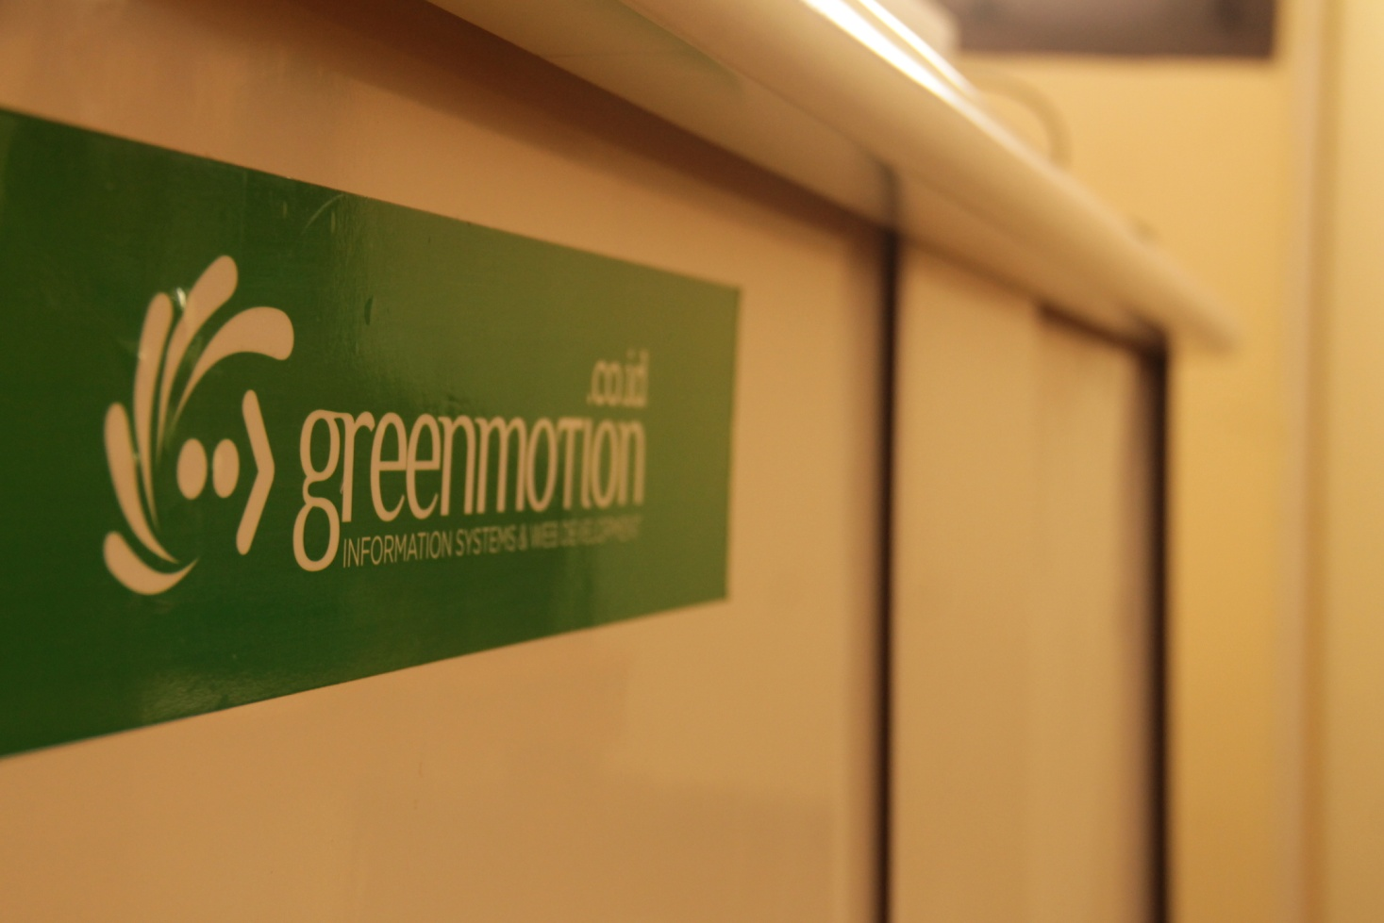
Green Motion

Slide 21
Human Ware
HumanWare is a company or people that focuses on using technology to help improve the lives of people.
In ICT Centre in UNISMUH there are Director of principle, and staff

Slide 22
No | Hardware | Educational Background
1 | Principle Amar Ma’ruf S. Pd, M. Hum | S1-Unismuh, S2-UNHAS, S3-UTM Malaysia
2 | Operator | 3

Slide 23
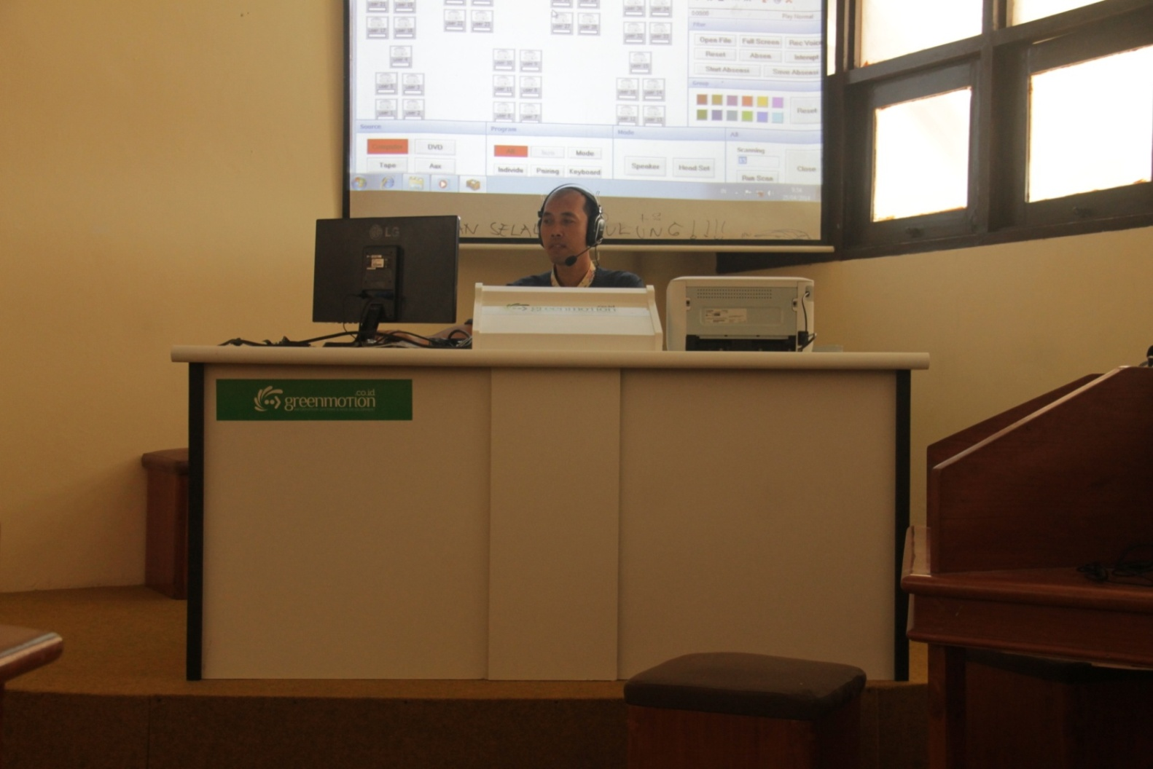

Slide 24
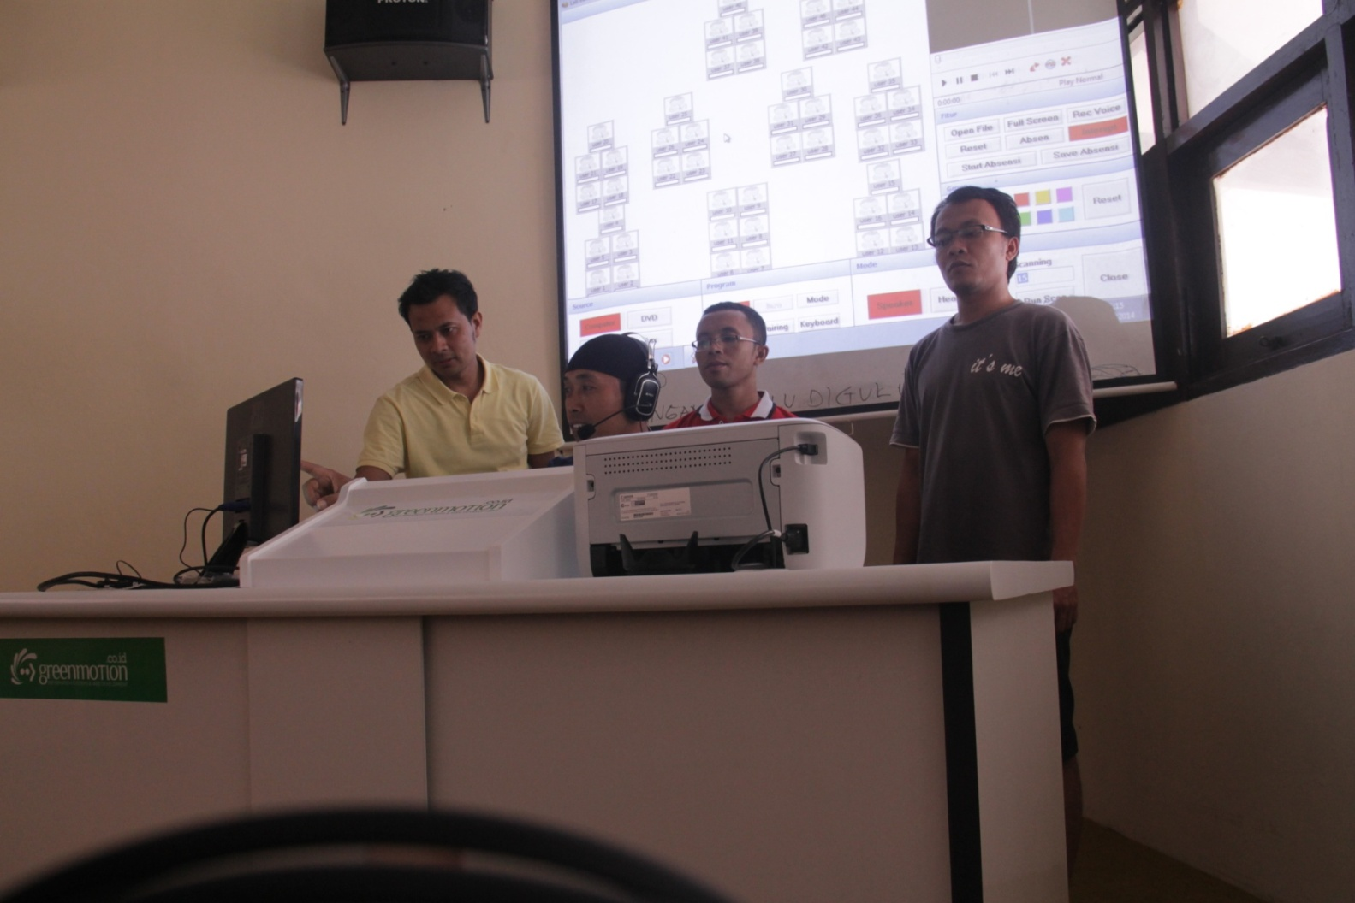

Slide 25
THANK YOU

