Slide 1
A VISIT TO
ICT CENTER UNM
Presented by Group 2 :
Dzakiah
Eka Pratiwi Sudirman
Ismi Fahriana Citra
Nur Husnil Khatimah
Sri Hariyati Mustari

Slide 2
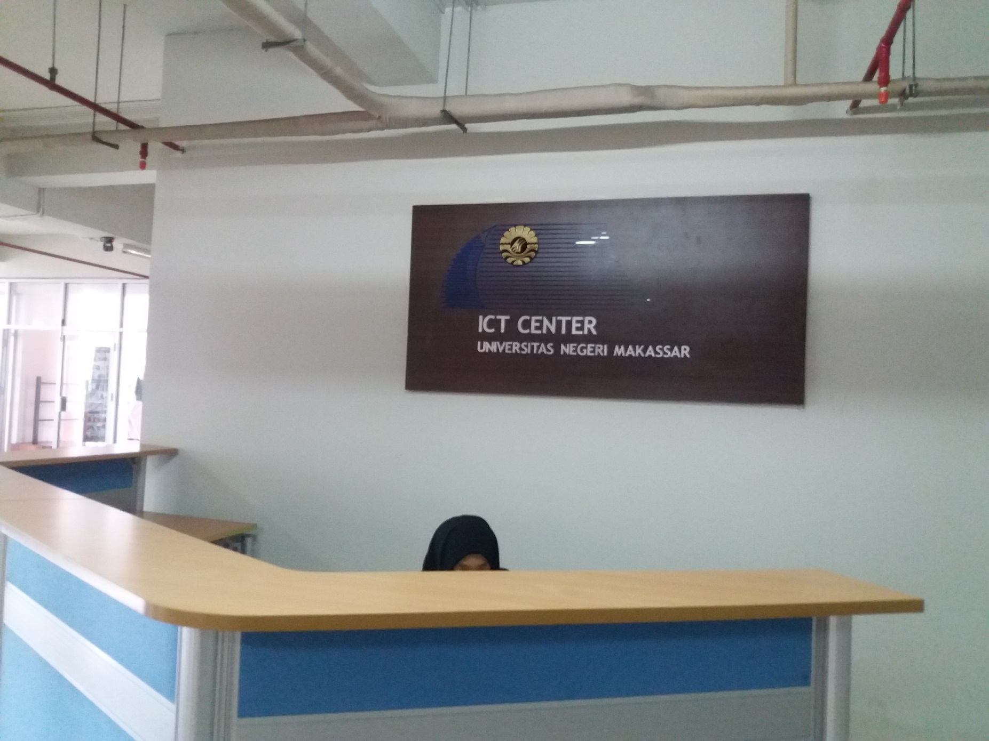

Slide 3
INTRODUCTION
Brief History of ICT Center UNM
ICT CENTRE is a supporting unit located at UNM which provides technology information and communication service for students, lecturers, staffs, and all people working at UNM. ICT centre was firstly established by centre team of information technology development (PPTI) in March 2005 under coordination of BKS/SISDIKSAT of UNM. In one-year period, this unit has some improvements in some services of ICT such as web server, e-mail server, and database server, the local computer network at campus in four locations in and out of Makassar.

Slide 4
ICT COMPONENTS OF UNM
HARDWARE
SOFTWARE
HUMANWARE

Slide 5
WHAT IS HARDWARE?
Hardware is the collection of physical parts of a computer system

Slide 6
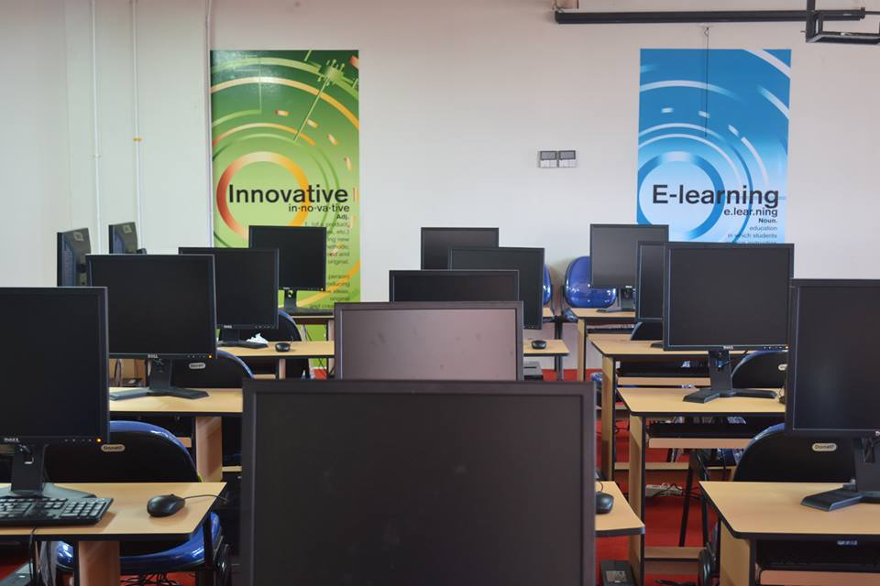
The hardware used at ICT UNM
Overall, there are 4 laboratories consisting of 2 main laboratories and 2 small labs. Each of 2 main laboratories (lab 1 & 2) has 50 computers and small labs (3 & 4) provide 30 and 40 computers respectively. For the staffs, there are about 10 computers and one controlling room for server unit located on 9th floor.

Slide 7
Pictures of hardware

Slide 8
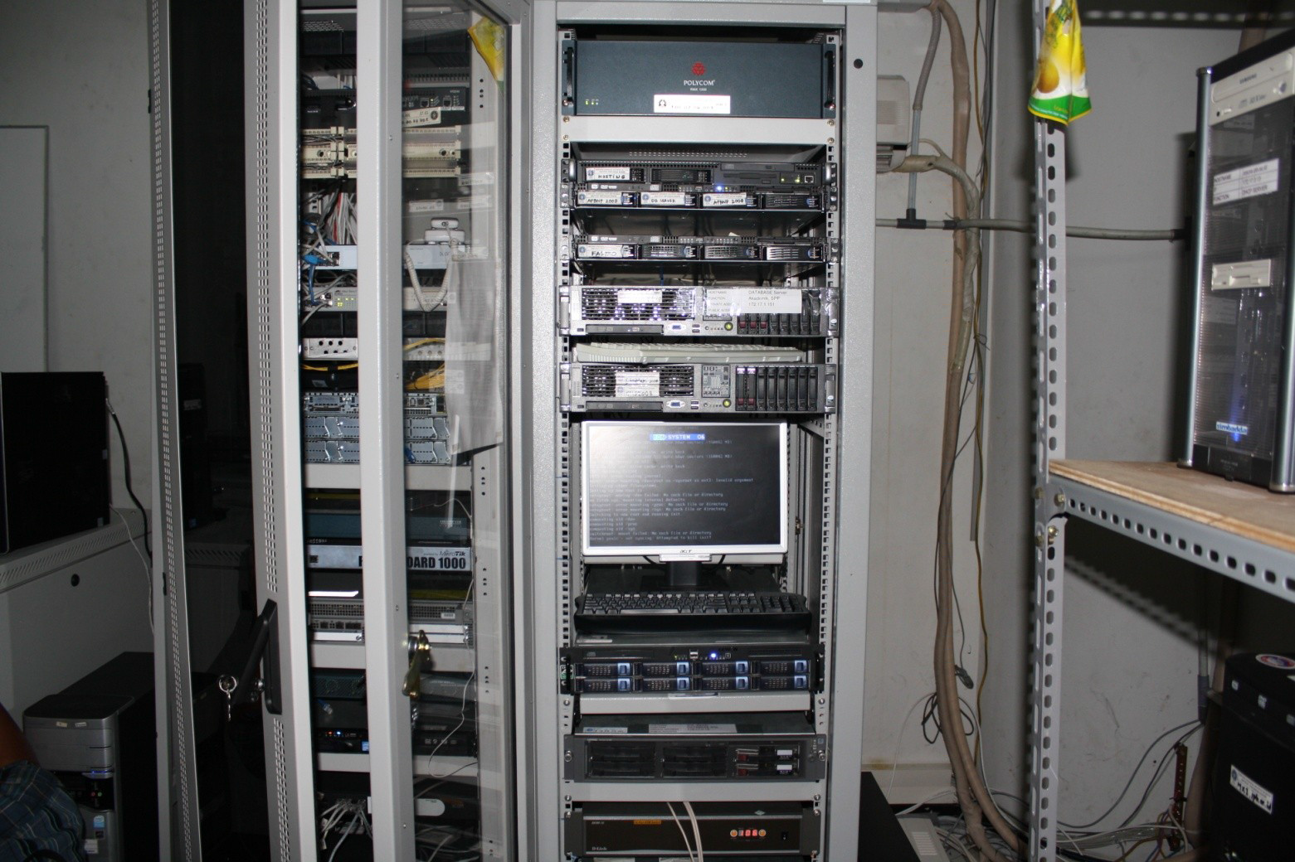
Pictures of hardware

Slide 9
software
Organized informations in the form of operating systems, utilities, programs, and applications that enable computers to work.

Slide 10
Software categories
System software
linux
Application software
ATO (aplikasi tes online)
simpadu

Slide 11
Humanware
Humanware or peopleware refers to the role of people in the computing process. Peopleware is sometimes considered the third component of computing besides hardware and software.

Slide 12
The operators of ICT centre in UNM
Drs. Rusli M.Pd
Direktur
Nurul ikhsan, S. Si, M.Si
sekretaris
Ridwansyah, S.T, M.T
Amir Ali, S.T, M.T
Sulkifli A.Pd.Kom
Syamsir, S.Kom
Imran, S.Pd
Abrar firdaus
Hartoto
Nilma Ira Akil, S.Soss

Slide 13
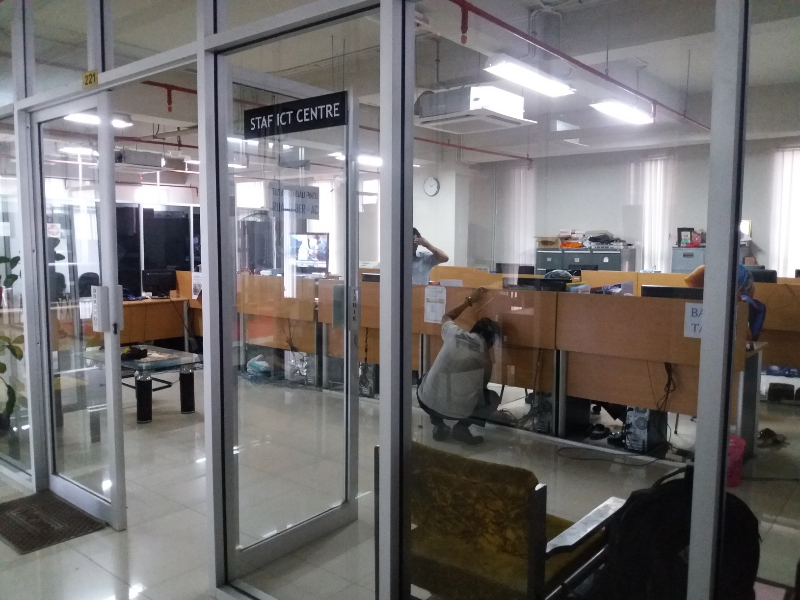

Slide 14
THANK YOU

