Slide 1
A Visit to an ICT Facility
Group 1:
Rosyanti 15B01160
Rizki Damianty 15B01159
Riska Arnas 15B01158
Hariyana Binti Abd.Wahid 15B01151

Slide 2
OVERVIEW
Respondent: Firman Onjhy, S. Pd, M. Pd
(A lecturer of English Department of Unismuh Makassar)
ICT Building: Language laboratory of English Department of Unismuh Makassar

Slide 3
LIST OF QUESTIONS
Is there any particular software used in the laboratory?
Is the software operated online or offline?
What is the purpose of the use of the software?
Is the software always used in teaching and learning process?
When was the software firstly used?
What problems are usually encountered in the use of the software?
How is the software maintained?

Slide 4
FINDINGS
Language laboratory of English Department of Unismuh Makassar uses a particular software called Language Laboratory Program Based on Personal Computer (PC)
LLP is operated offline
Lecturers use LLP for teaching listening
LLP is regularly used from meeting two to fourteen

Slide 5
FINDINGS
LLP was firstly used in 2013
Problems:
a. Audio (sound) is not clear.
b. Video is blur
c. Black out
Software maintenance is applied once in six months or once in a year

Slide 6
CONCLUSION
SOFTWARE
Language Laboratory Program Based on Personal Computer (PC)
HARDWARE
Computer
Earphone
Control device
HUMANWARE
Head of laboratory
Lecturers of English department
Technician

Slide 7
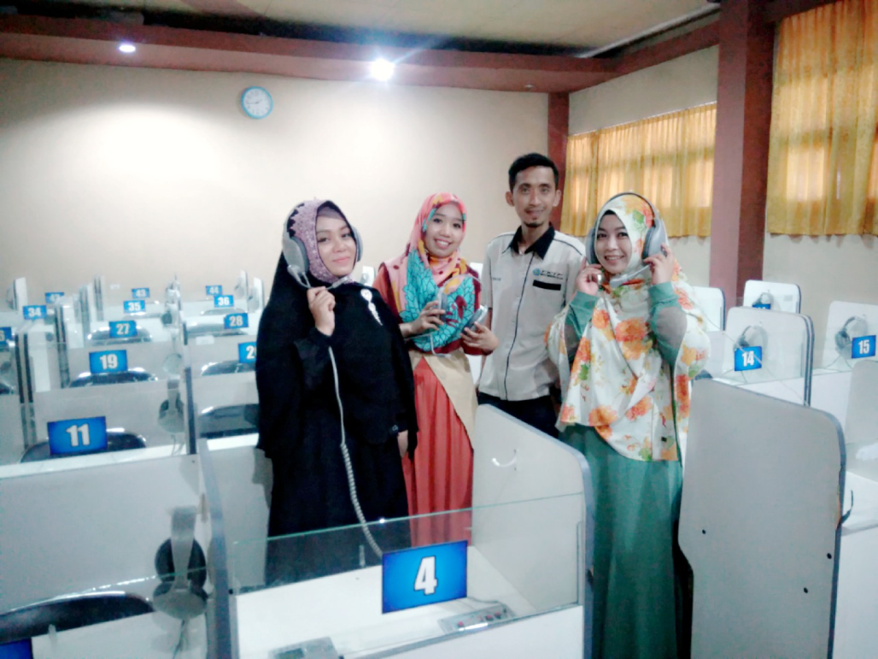
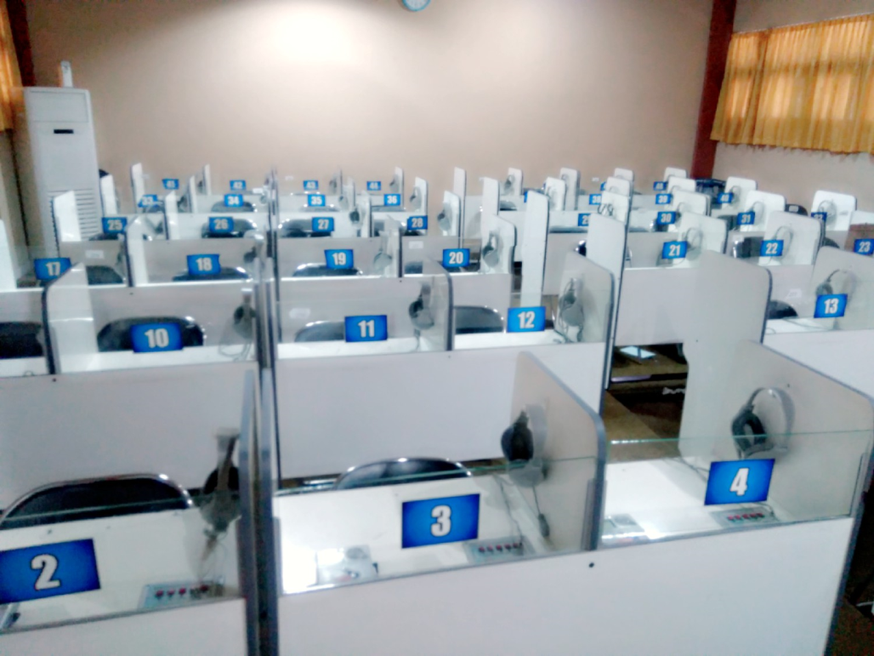
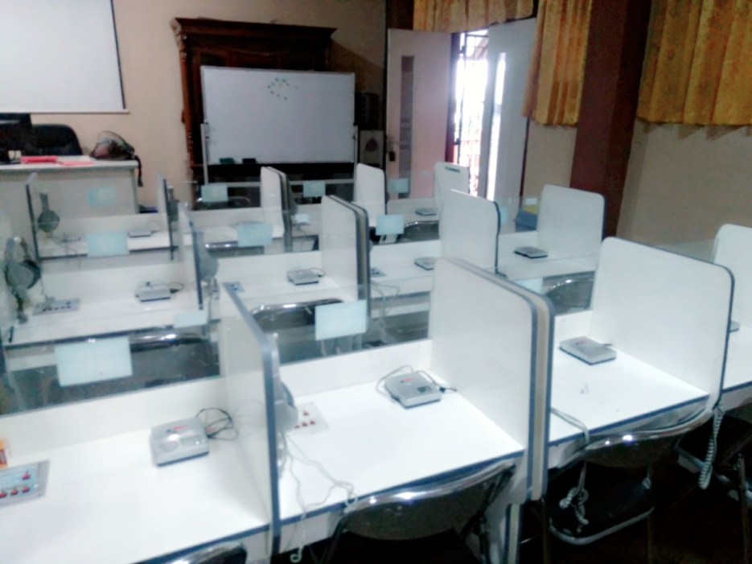
APPENDICES

Slide 8
Thank You

