Slide 1
Information and communication technology (ICT) in Language center of universitas islam negeri alauddin makassar (UINAM)
Group 4
Heri alfian
Andi lukman ali lalo
Arifuddin
Azwar assiddiq
Achmad taqlidul CF
Sitti rahmayanti

Slide 2
ICT
What is ICT?
UINAM language center
Aspects of Technology
Aspects of Technology in UINAM

Slide 3
What is information and communication technology (ICT)?
Consists of 3 words;
Information
Shannon (1948) identified the critical relationship among the elements of a communication system
Communication
“communication is transfer of information from one person to another, whether or not it elicits confidence, but the information transferred must be understandable to the receiver”,
G.G. Brown
Technology
Design for instrumental action that reduces the uncertainty in the cause effect relationships involved in achieving a desired outcome (Rogers, 1983)

Slide 4
Language center of UINAM
Stated in 2010
Located in Universitas islam negeri alauddin makassar (uinam) Samata (Kampus II)
Advance computer laboratory in UINAM
History

Slide 5
Aspects of technology
Rogers (1986)
Hardware
Software
Sadjad (2013) added one more aspect
humanware

Slide 6
Aspects of technology in universitas islam negeri alauddin makassar (UINAM)
Hardware
30 unit computers + 1 main computer, custom desks
2 speakers with pure quality
LCD
Earphones
Guidance book
Speedy internet

Slide 7
Aspects of technology in universitas islam negeri alauddin makassar (UINAM)
Software
Sanako lab 300
Windows XP
Microsoft office 2003
Anti-Viruses

Slide 8
Aspects of technology in universitas islam negeri alauddin makassar (UINAM)
Humanware
Eight people in different division
Teacher, trainer, tester, interpreter
Whole students of UINAM
General students (training participants, tOEFL and TOAFL testes

Slide 9
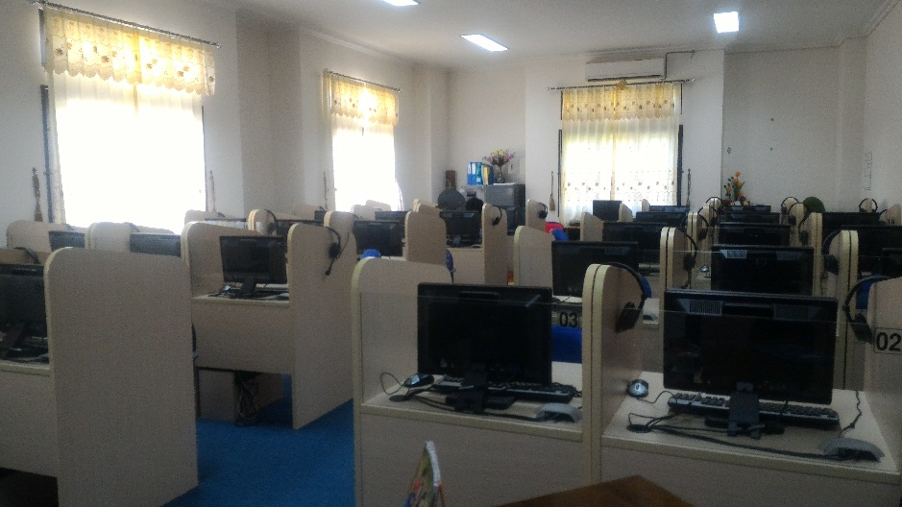
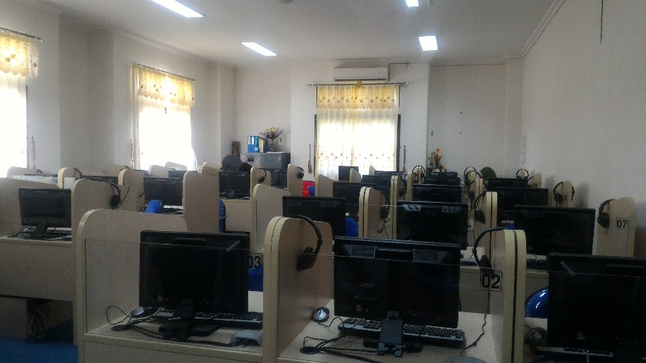
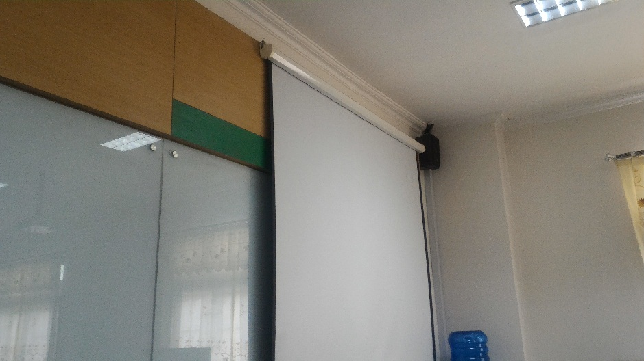
documentation

Slide 10
THANK YOU

