Slide 1
Recognition of Car License Plate using Morphology
Esmail Hadi Houssein
ID/2700213044

Slide 2
Outline
Motivation
Problem Overview
License plate segmentation
Character segmentation
Character Recognition
Results and discussions
Conclusion

Slide 3
Motivation
Automatic license plate recognition could be used to automatically open a gate or barrier into a secured area for authorised members. This could replace or assist security guards at the gates or barriers of premises.
If a vehicle is stolen, it could be marked in the license plate recognition system as so. If at any point the stolen vehicle happens to pass a camera on the roadside that belongs to the license plate recognition system an alarm is set off to alert a guard.
To control the Traffic flow management.

Slide 4
Problem Overview
Source car image
License plate detection
License plate character segmentation
Segmented character recognition

Slide 5
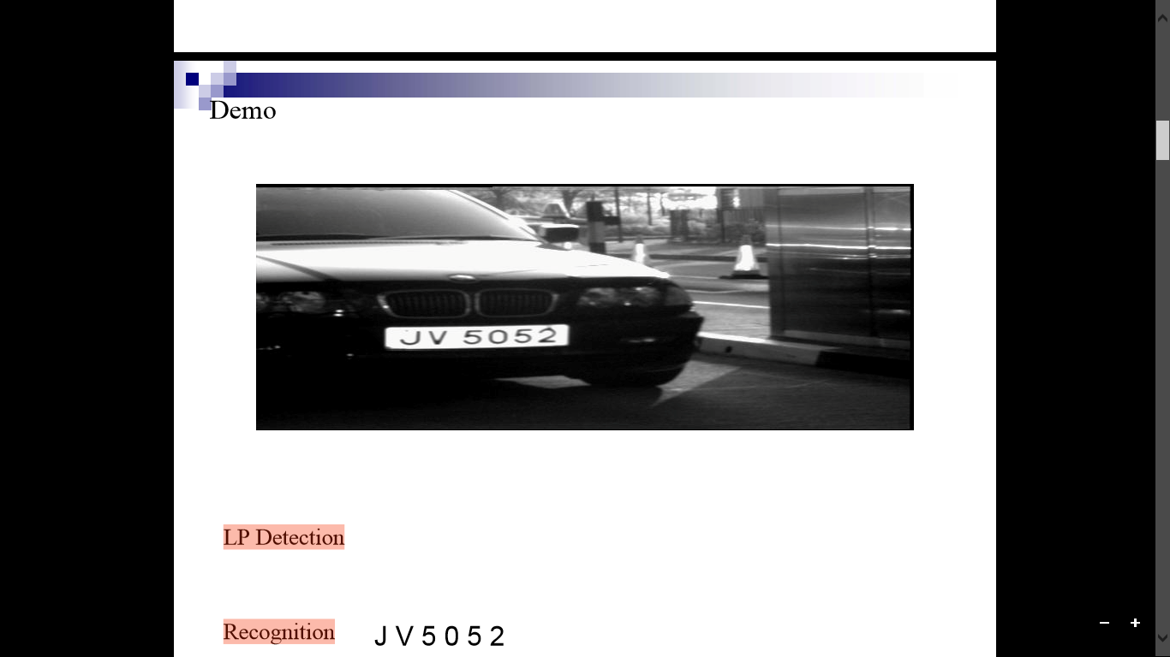
LP Detection
Recognition
J V 5 0 5 2

Slide 6
License Plate Detection
Vertical edge detection 
Morphological operations
Connected component analysis

Slide 7
Character Segmentation
Skew correction
Hough transform method is the simple way to determine the tilting angle for the plate.
In the ρ-θplane of license plate image, the angle at which accumulator cell shows maximum value is becomes the skew of image.

Slide 8
License Plate Detection
Vertical edge detection
Morphological operations
Connected component analysis

Slide 9
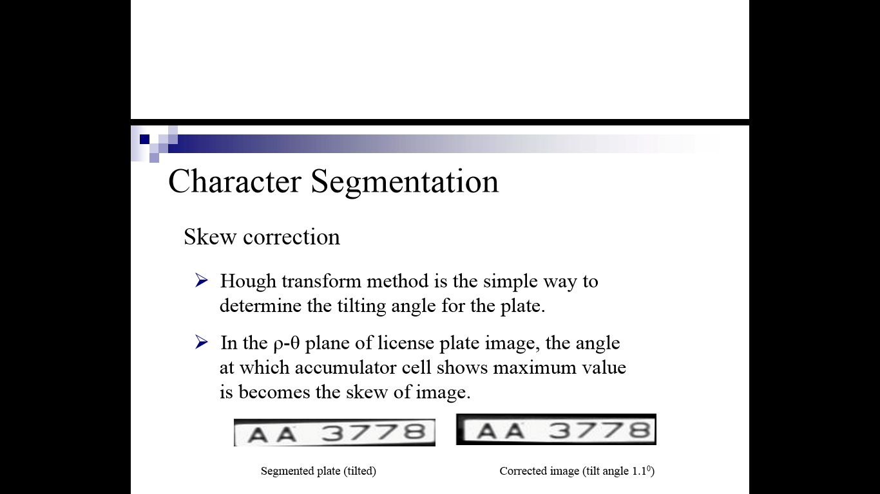
Character Segmentation
Skew correction
Hough transform method is the simple way to determine the tilting angle for the plate.
In the ρ-θplane of license plate image, the angle at which accumulator cell shows maximum value is becomes the skew of image.
Segmented plate (tilted)
Corrected image (tilt angle 1.10)

Slide 10
Projections on Binary image
Projections on Binary image
The isolation of the license plate from any superfluous background is performed using a histogram that reflects the number of black pixels in each row and in each column.
Horizontal projection
Vertical projection
Binarized image
Segmentation of characters

Slide 11
Character Recognition
Template matching is one of the most common and easy classification methods for recognizing the characters.
Size of character images are same as the templates and each pixel in the extracted character image from the ¾license plate is compared to its corresponding pixel in the template.
Segmented character images are scaled to size of the templates using bilinear interpolation prior to matching.
Constructing Database of templates.

Slide 12
Results
License Plate Segmentation
Car images on left containing obscured license plates and segmented license plates on right

Slide 13
Car images on left containing texture like road and segmented license plates on right side

Slide 14
Car images on left containing brand names along with license plates and segmented license plates on right

Slide 15
Comparion with an existing technique[4] method

Slide 16
Recognized plates
(a) Inseparability of characters from background texture
(b) Obscured license plates
(c) Presence of special symbols on plates
(d) Scratches on plates causes character breaking
License plates failed in recognition

Slide 17
Accuracy of LPR
Country | Database size | Extracted license plates | Test data size | Recognized license plates
Hong Kong | 25 | 25 | 41 | 38
China | 319 | 31 | 50 | 44
India | 19 | 19 | 29 | 26
Europe | 54 | 54 | 74 | 65
South Africa | 19 | 19 | 28 | 25
Brazil | 75 | 75 | 102 | 85
Spain | 98 | 98 | 145 | 127

Slide 18
Accuracy of LPR
Test set 1 | Test set 2 | Test set 3
86.25% | 90.62 % | 88.75%

Slide 19
Conclusion
Detection works for complex environments like low illumination, image containing multiple background objects, texture and brand names
Accuracy of LP detection is 100% for country wise parameters and 95% for global case.
LP Recognition accuracy on average from test sets is 88.54%
Features like character height, spacing, LP height and width are used for LP detection.

